Slide 1
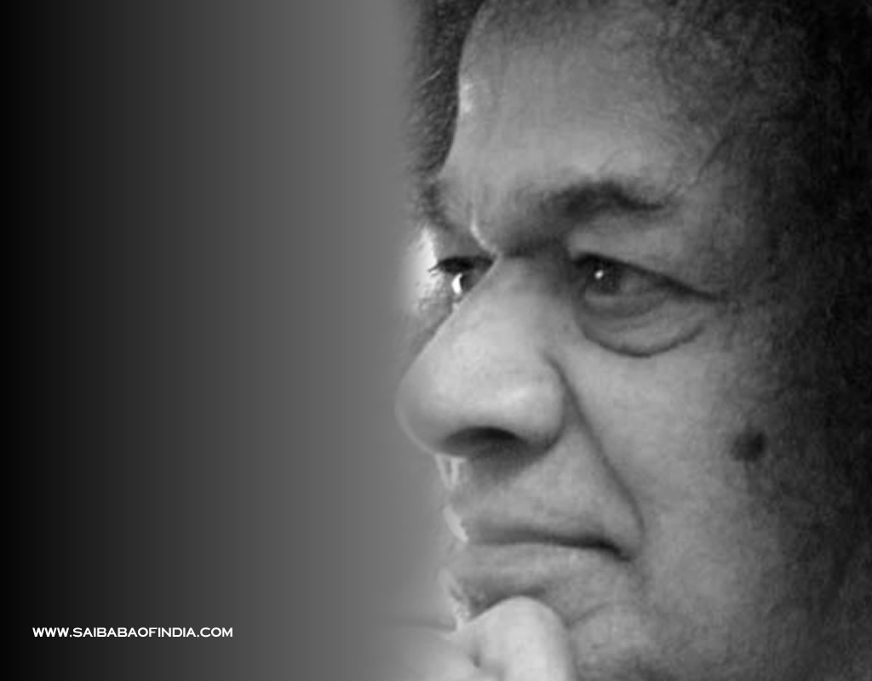
Satya Sai Baba Center of Peninsula
Next: Vedic Chants
Notes:
1

Slide 2
Aum, Aum, Aum
Notes:
2

Slide 3
Significance of Vedas
The Vedas are the recordings of sages to whom the mantras were revealed. Veda is derived from the root "Vid", which means "to know". The Vedas teach how to achieve purity of heart, getting rid of impurities. The Vedas have a universal outlook, embracing all that is noble and sacred. They have taught the principle of samatwa (equality) in respect of everything. They have proclaimed the concept of oneness. They taught men to face joy and sorrow with equal serenity. -BABA

Slide 4
Ganapati Prarthana
Om gananam tva ganapatigm havamahe kavim kavinamupama-śravastamam
Jyestha rajam brahmanam brahmanaspata anah śrrnvan-nutibhis-sida sadanam
We pray to the Lord of groups of demi-gods who removes obstacles. Omniscient with complete knowledge, You know more than any other being, I have come to you, recognizing your greatness, O Emperor of emperors! You are yourself Brahma, I have propitiated you with my chanting of adoring hymns and salute you for the fulfillment of my desires. You are the highest treasure among treasures. You grant you devotees both the treasure of food and the treasure of wisdom
Notes:
4

Slide 5
Ganapati Prarthana
Prano devi sarasvati vajebhir vajinivati
Dhinam-avitryavatu ganeśaya namah
sarasvatyai namah śri gurubhyo namah
harih om
We invoke Saraswati, the goddess of speech, May She be pleased with us and inspire our intelligence.
Prostrations to Ganesha, Saraswati and the Guru
Notes:
5

Slide 6
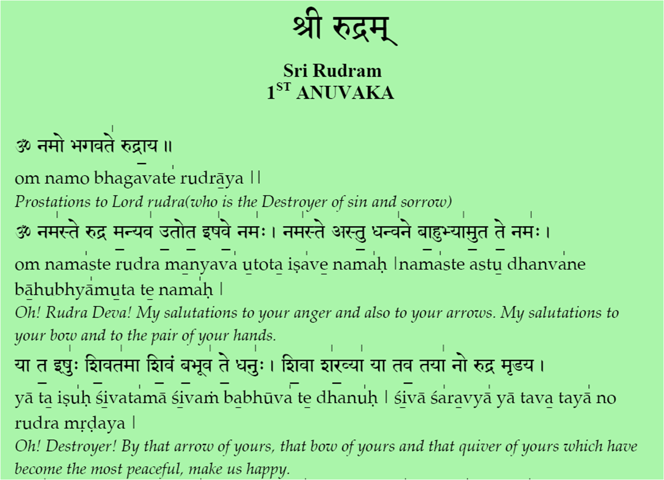
̱

Slide 7
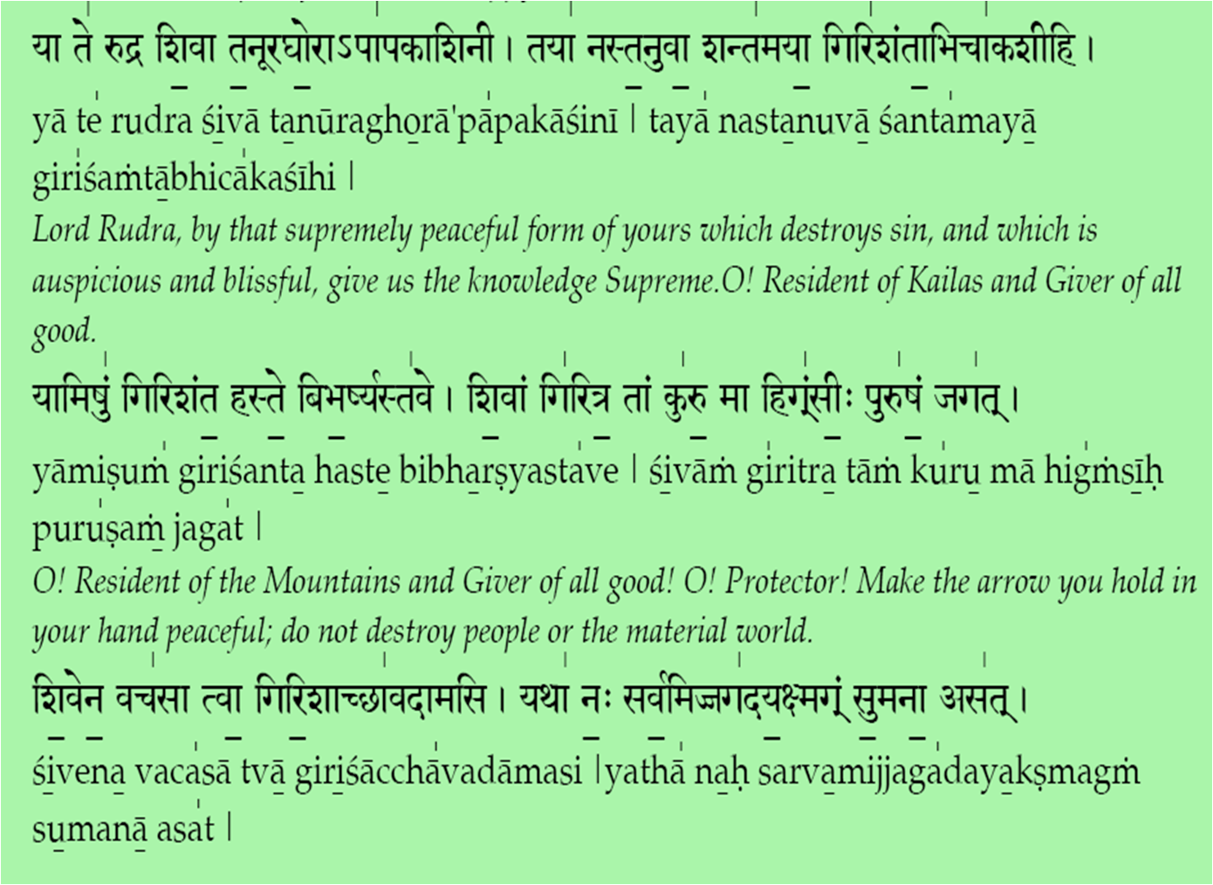
̱

Slide 8
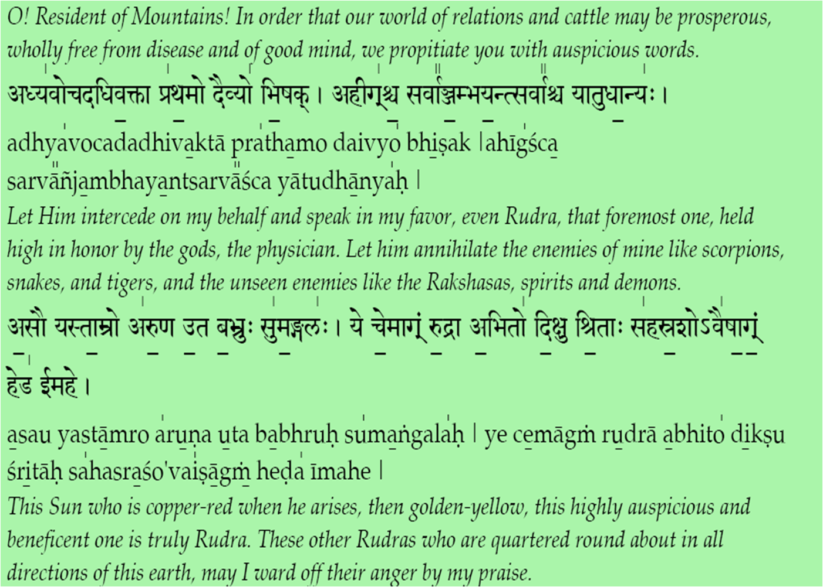
̱

Slide 9
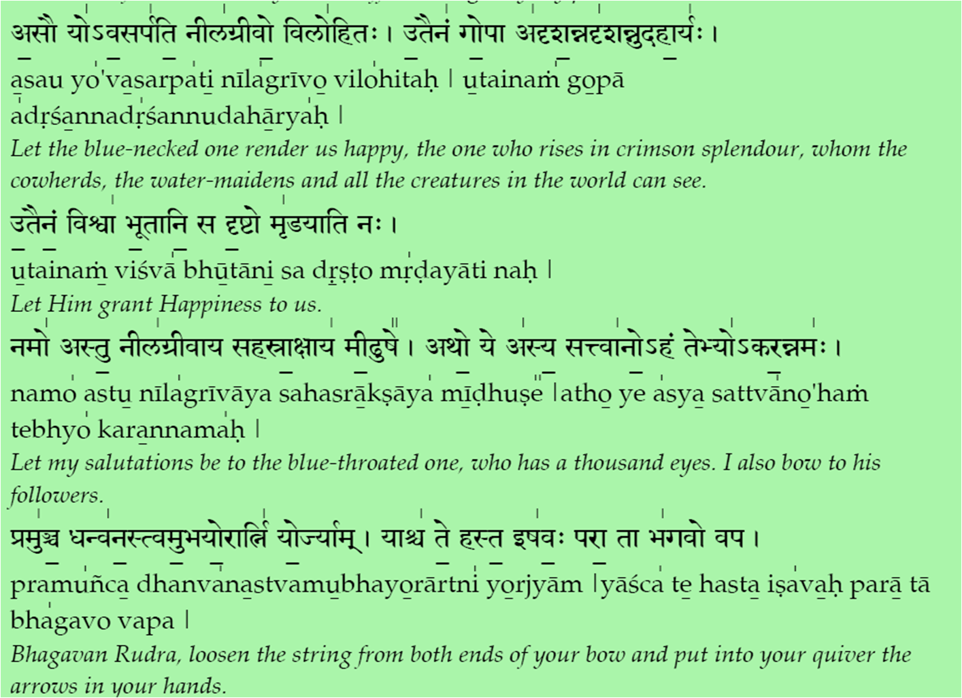
̱

Slide 10
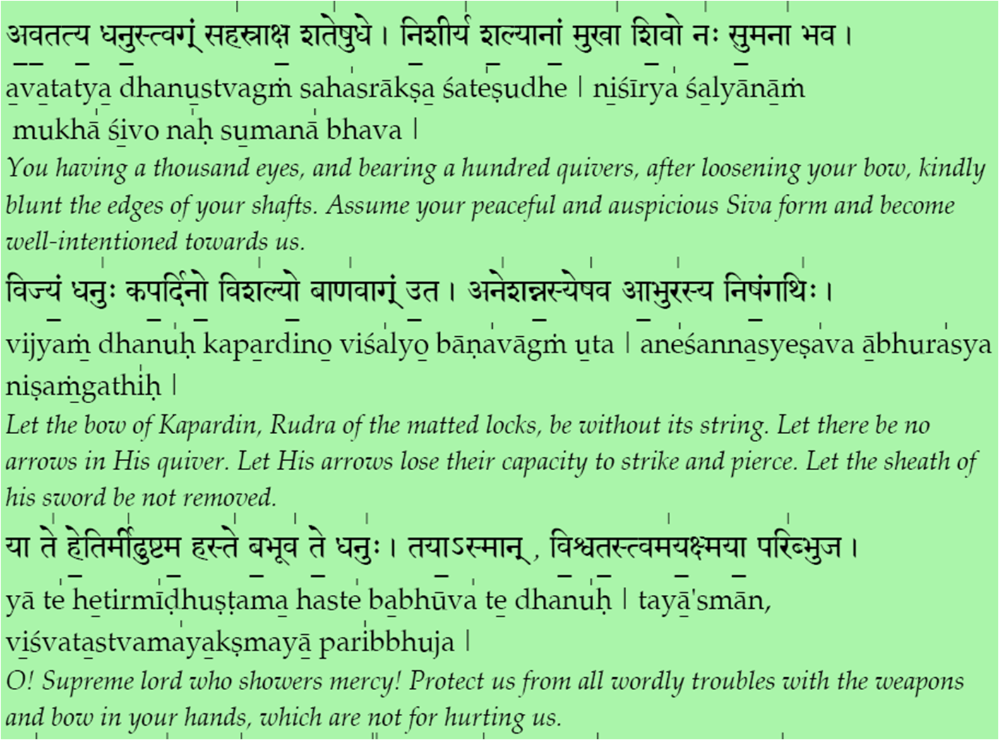
̱

Slide 11
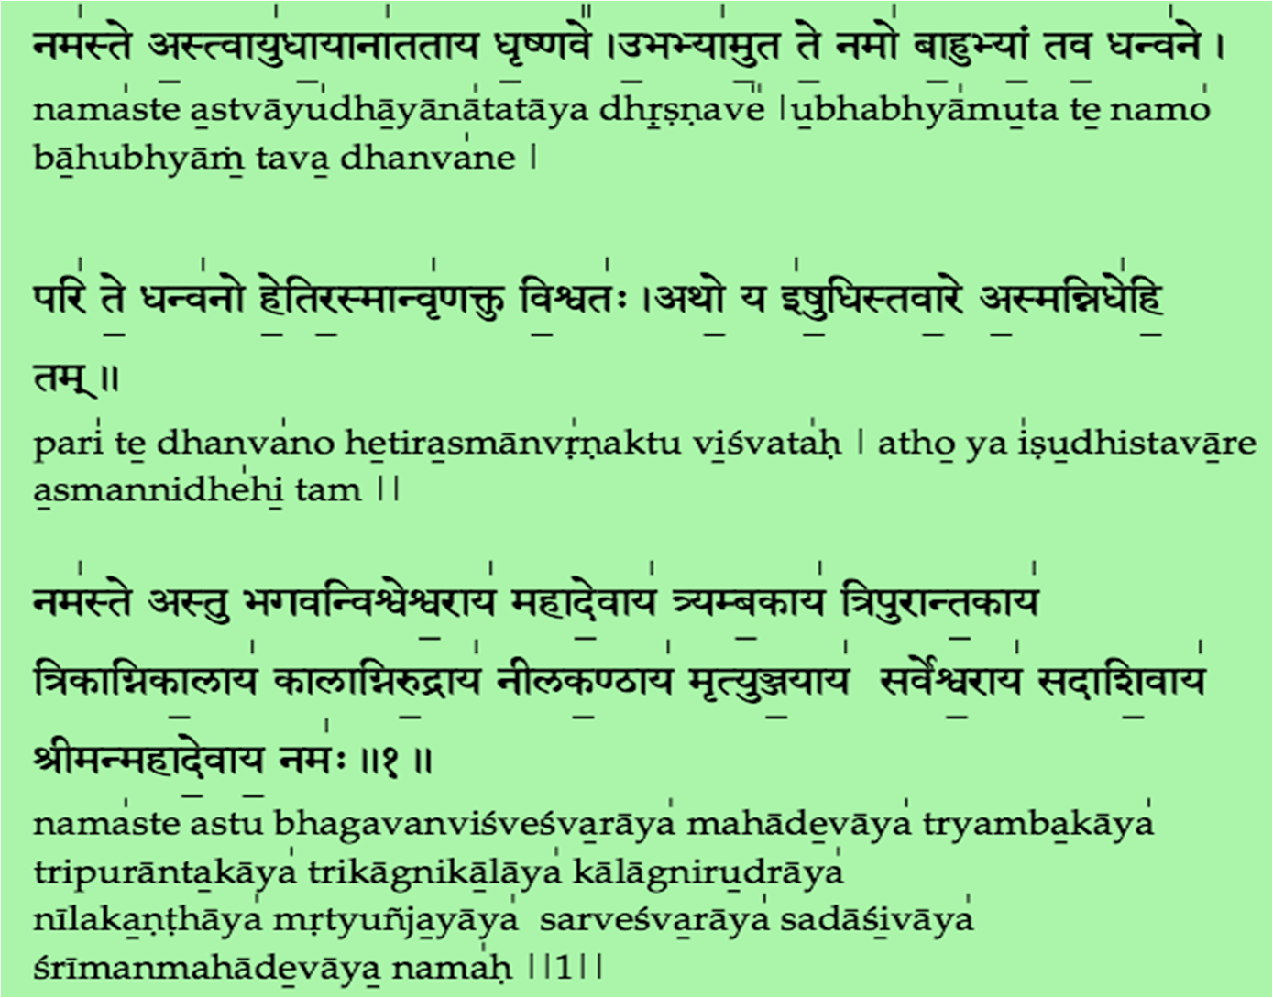
̱

Slide 12
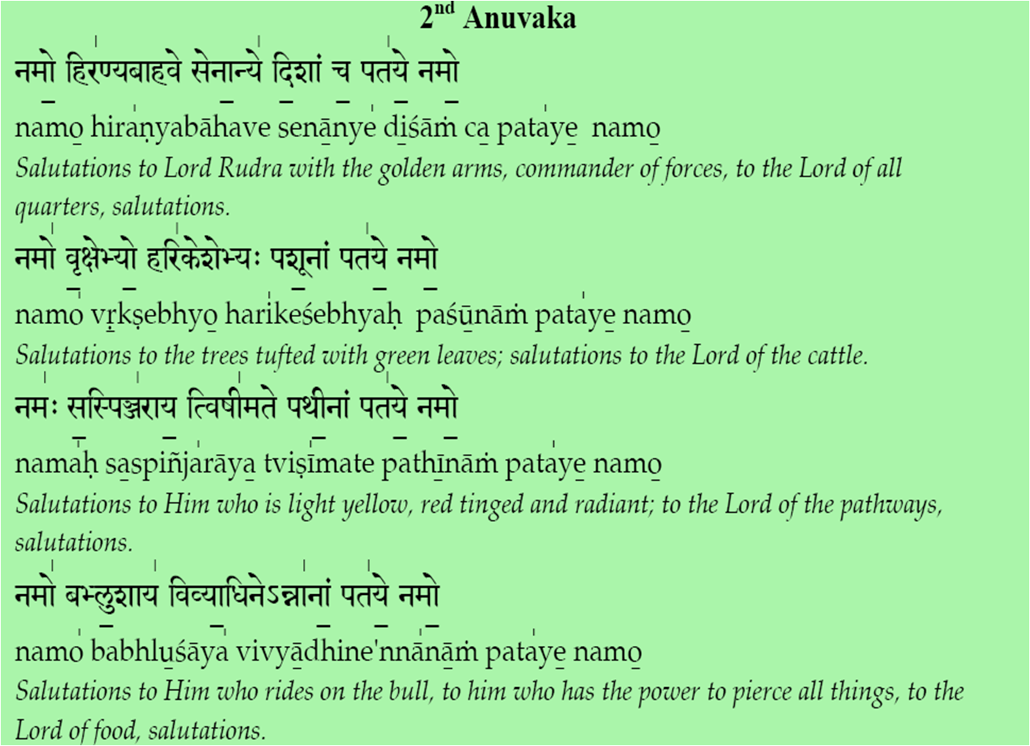
̱

Slide 13
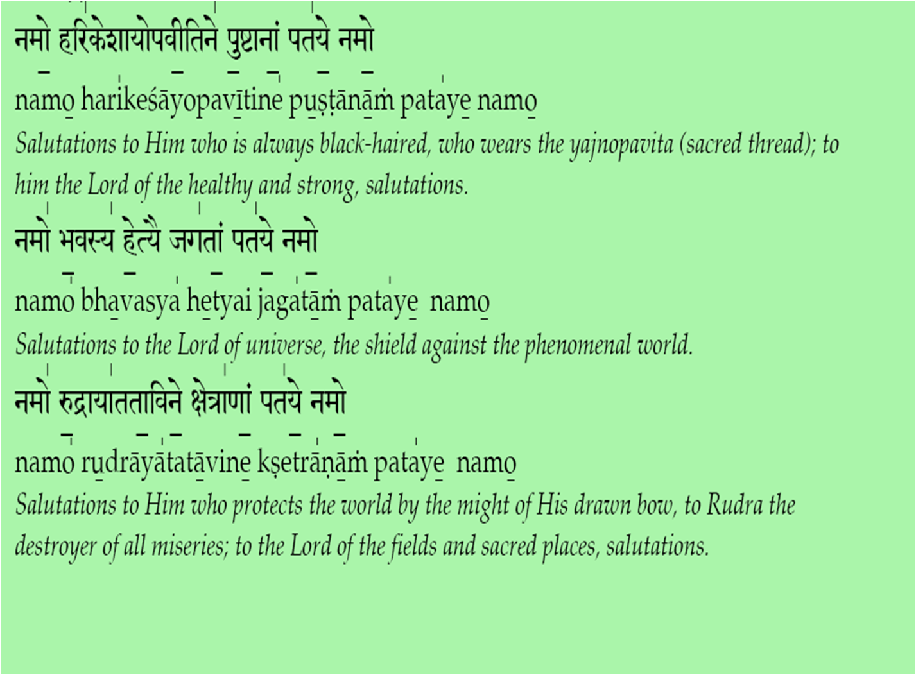
̱

Slide 14
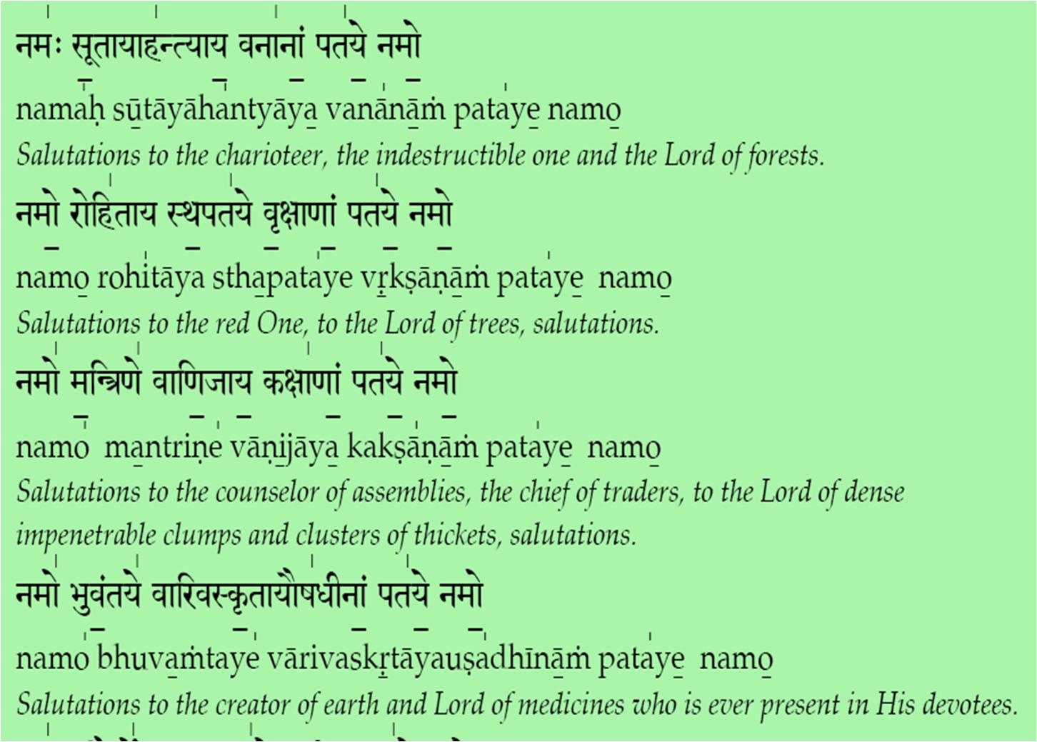
̱

Slide 15
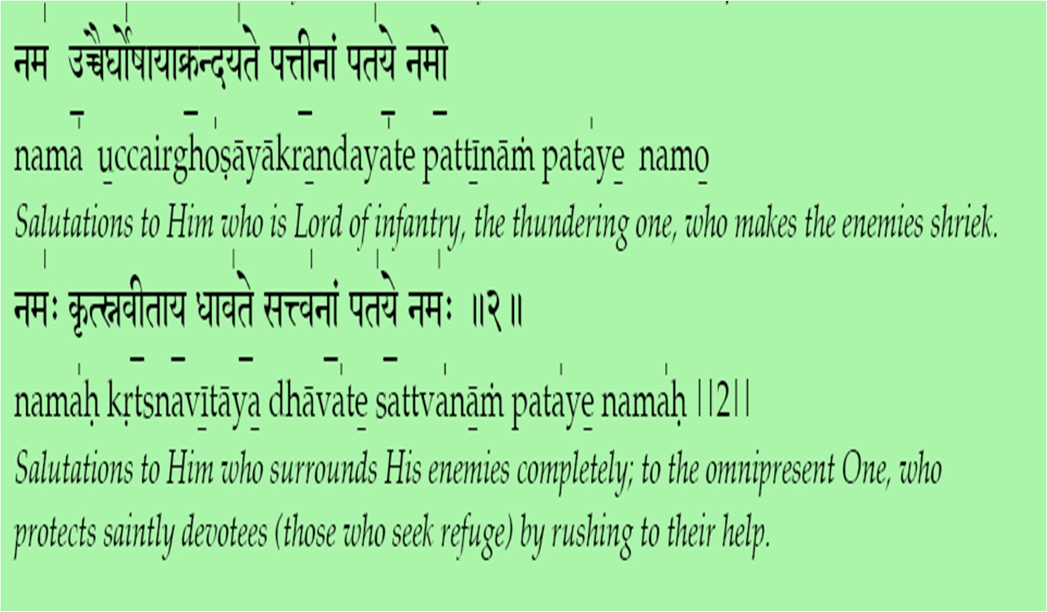
̱

Slide 16
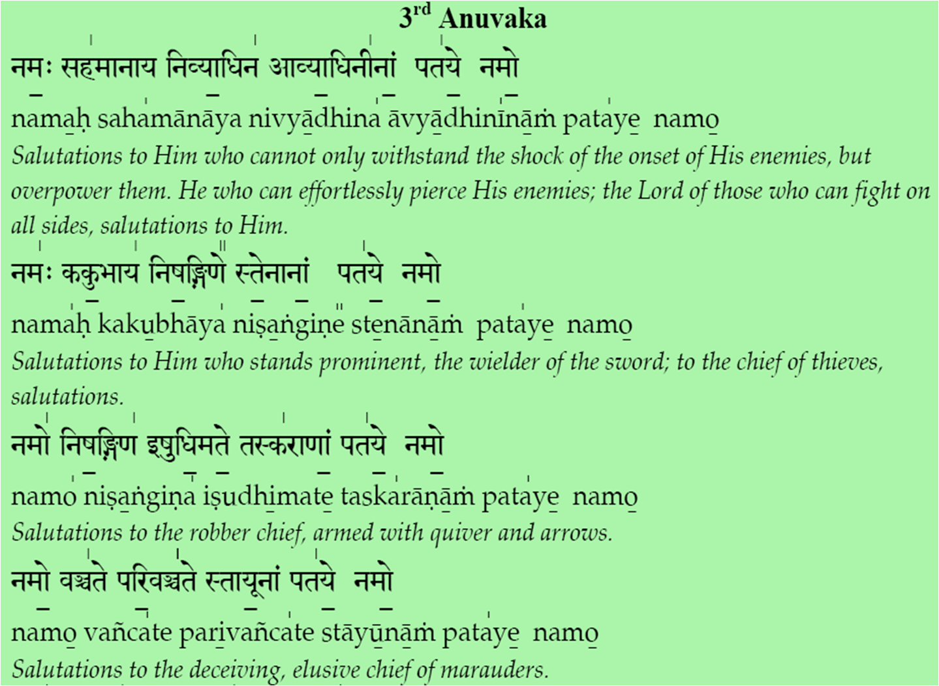
̱

Slide 17
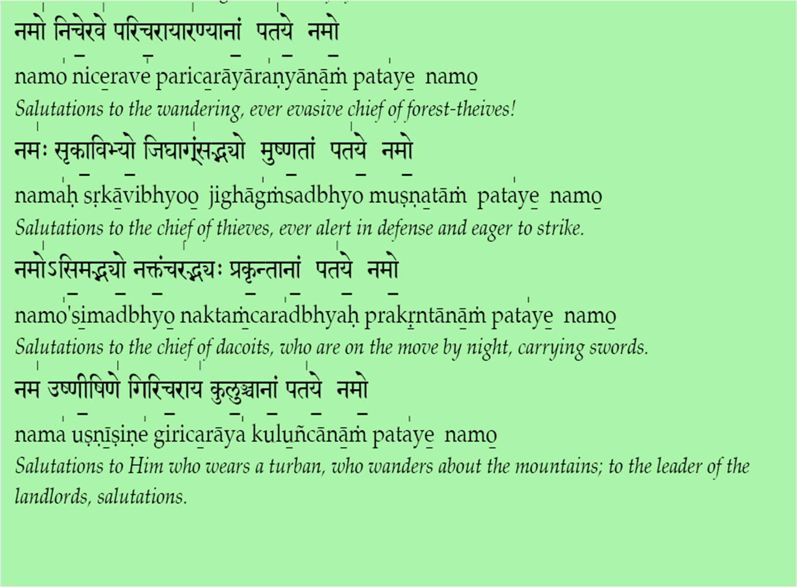
̱

Slide 18
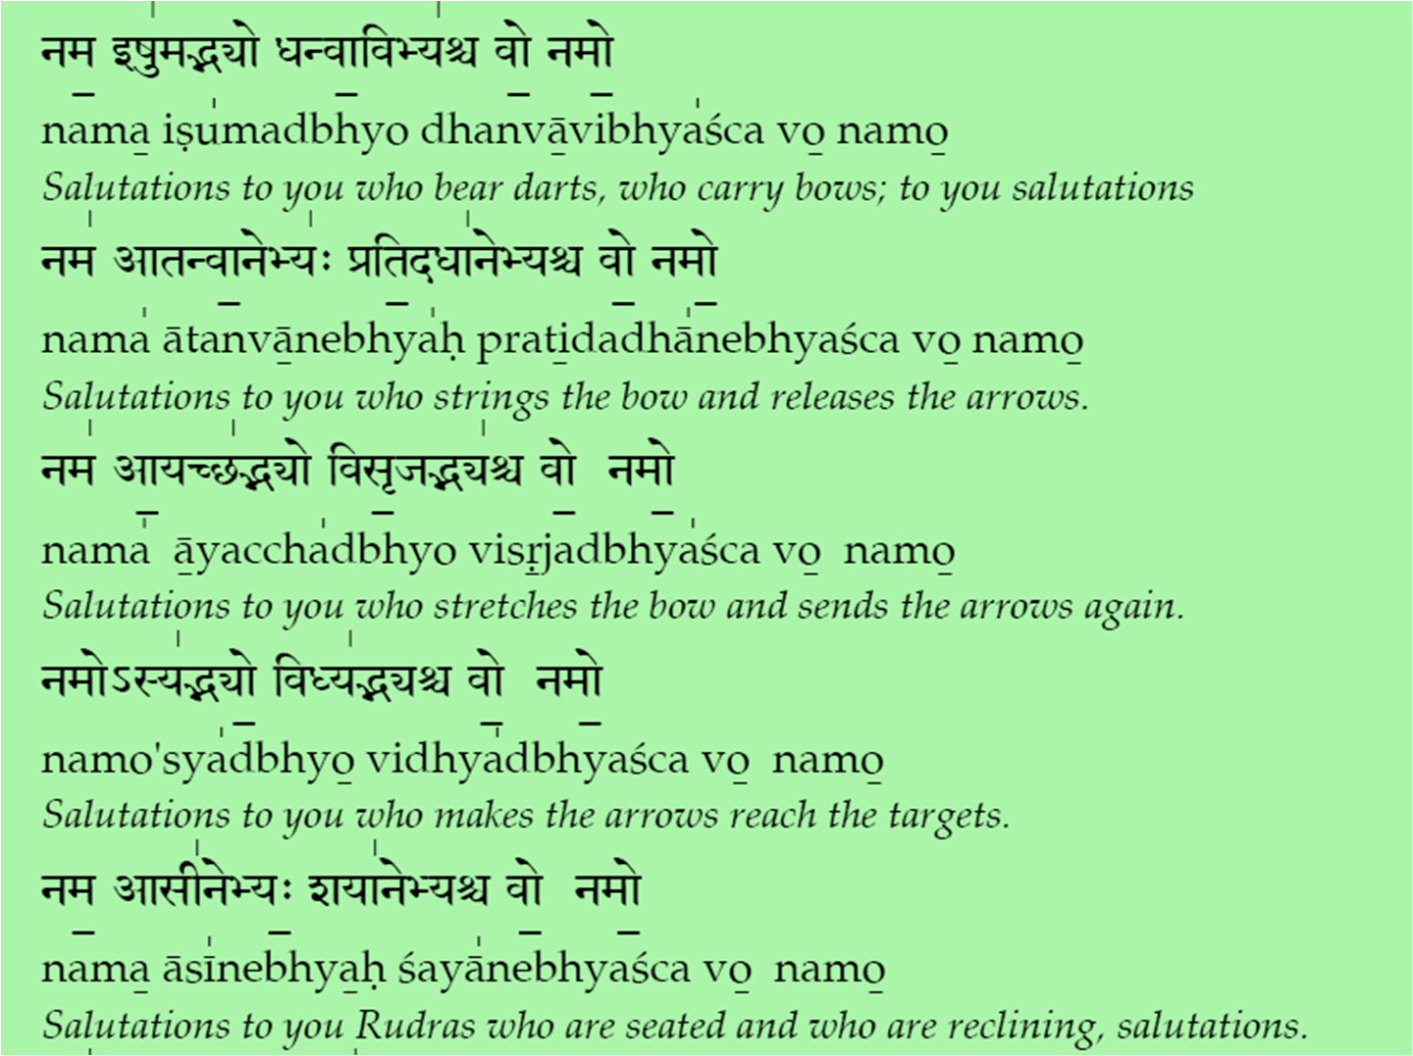
̱

Slide 19
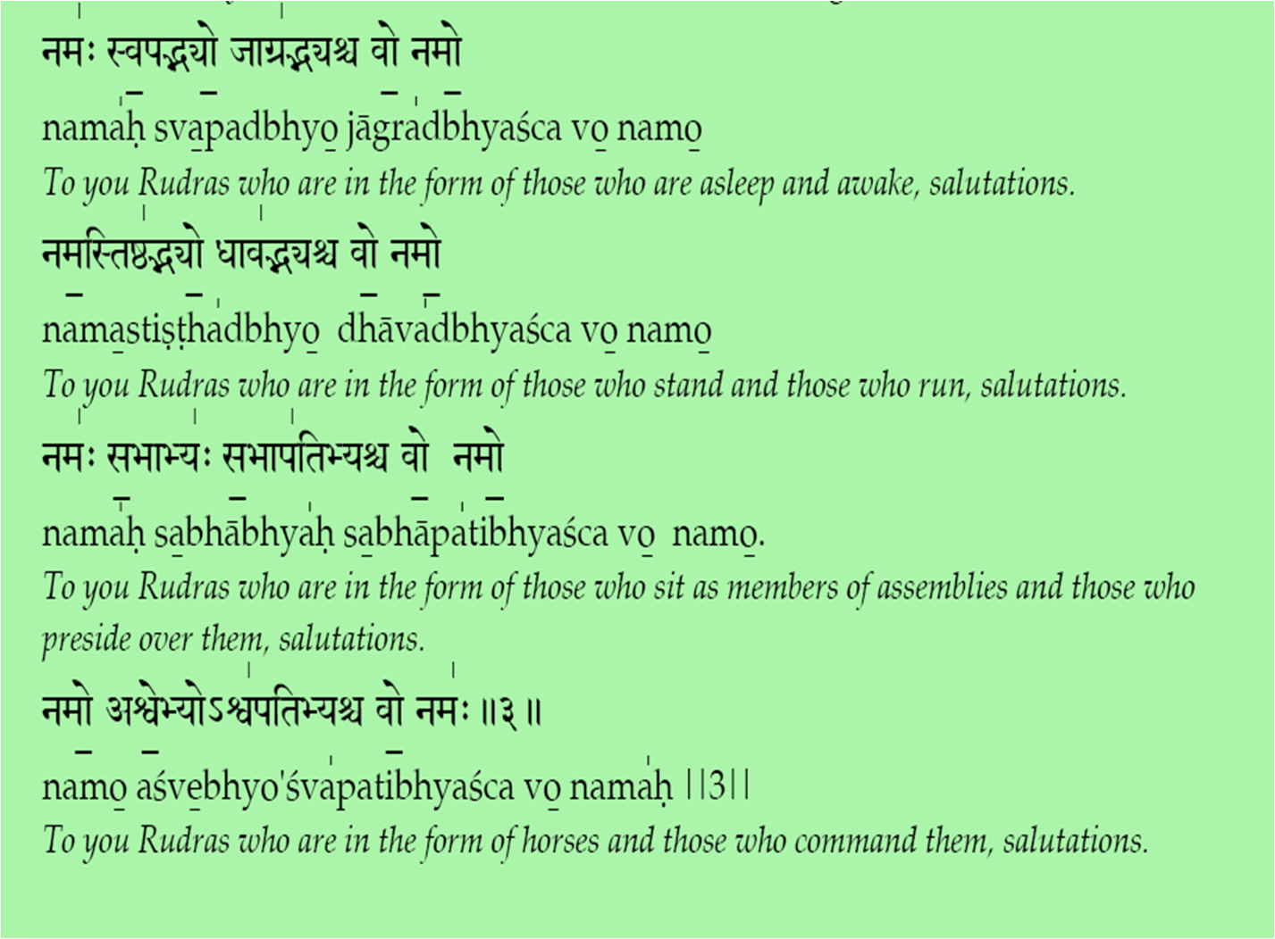
̱

Slide 20
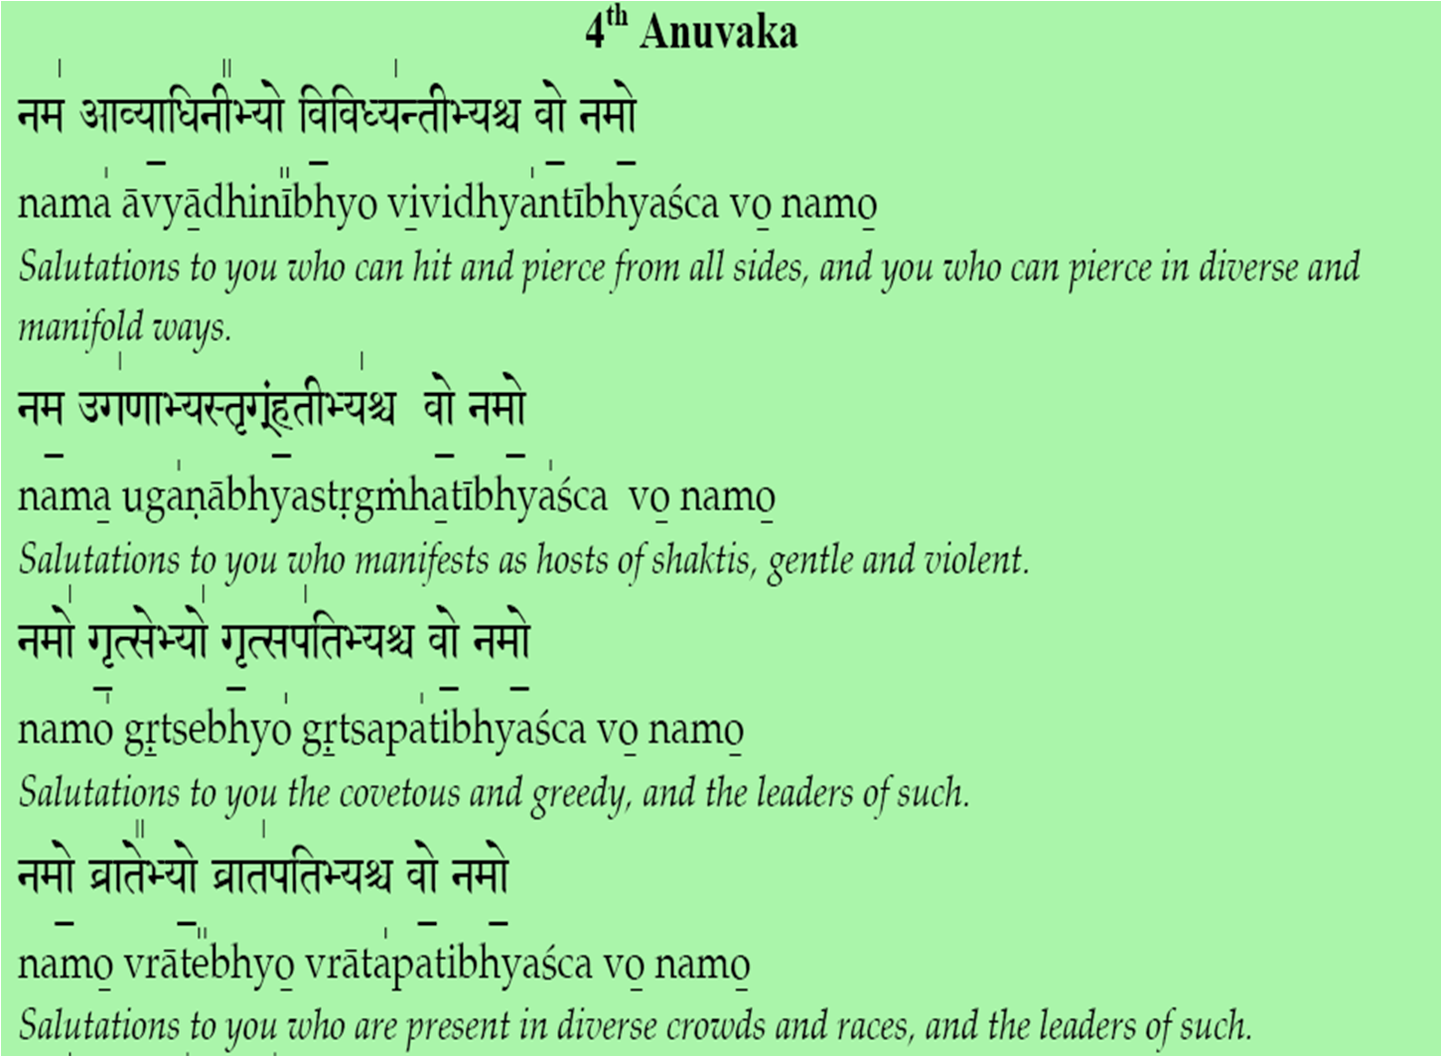
̱

Slide 21
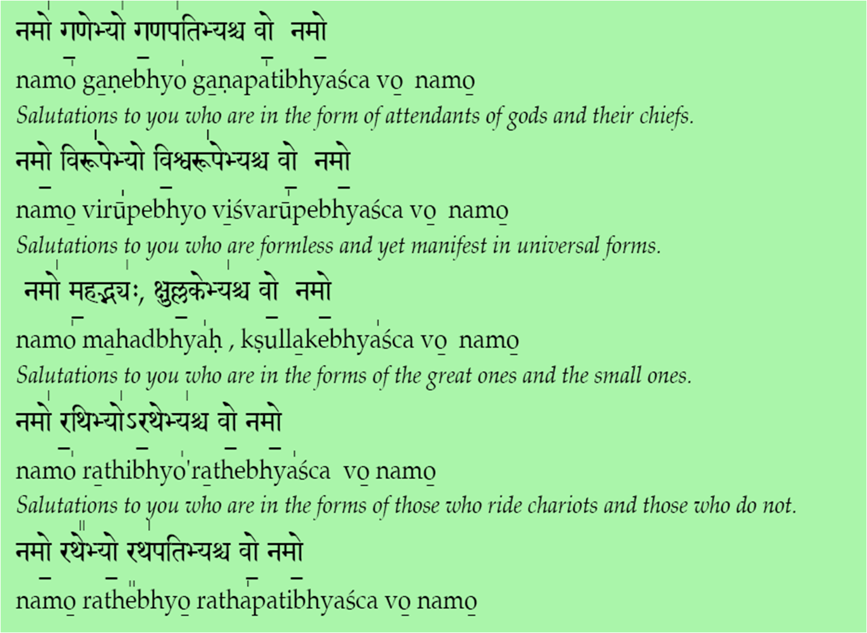
̱

Slide 22
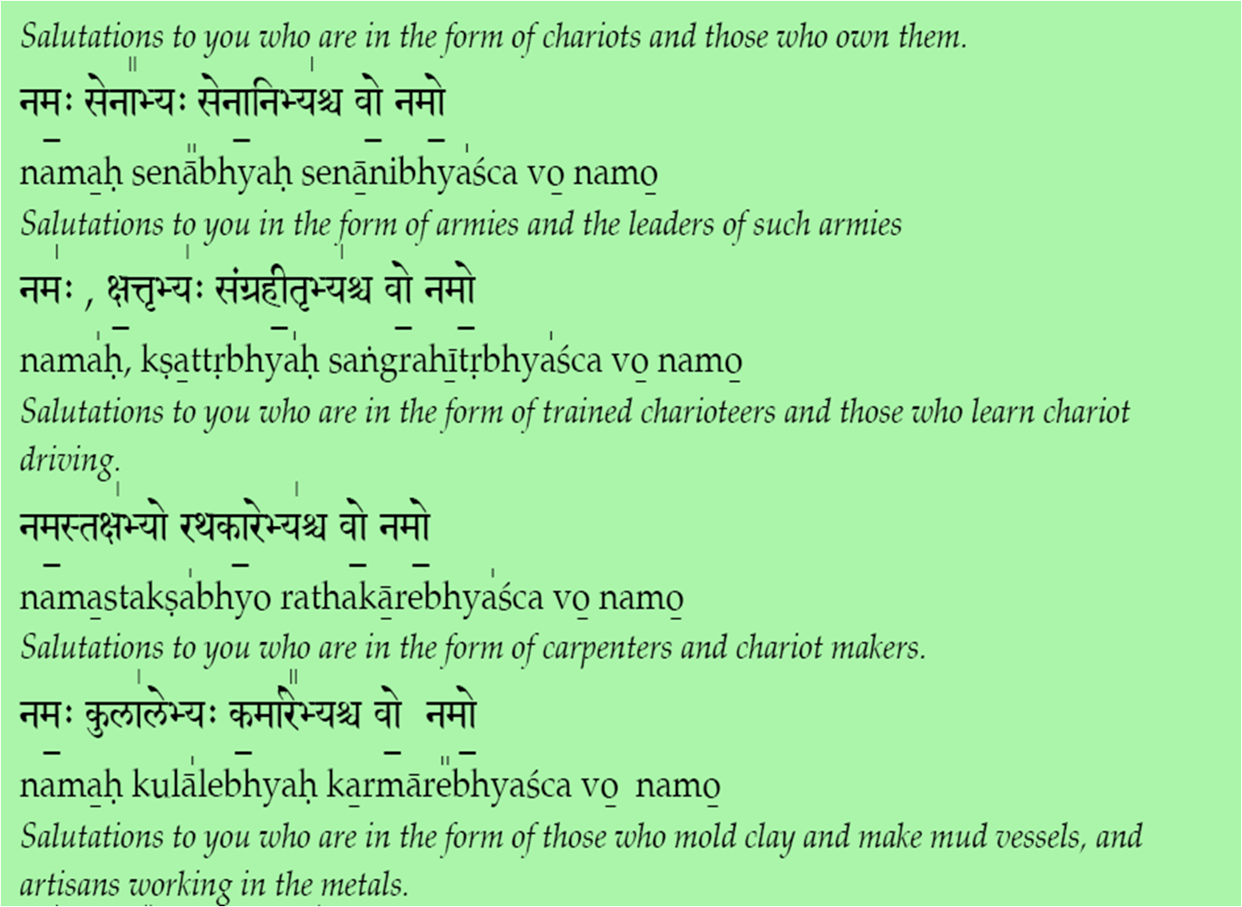
̱

Slide 23
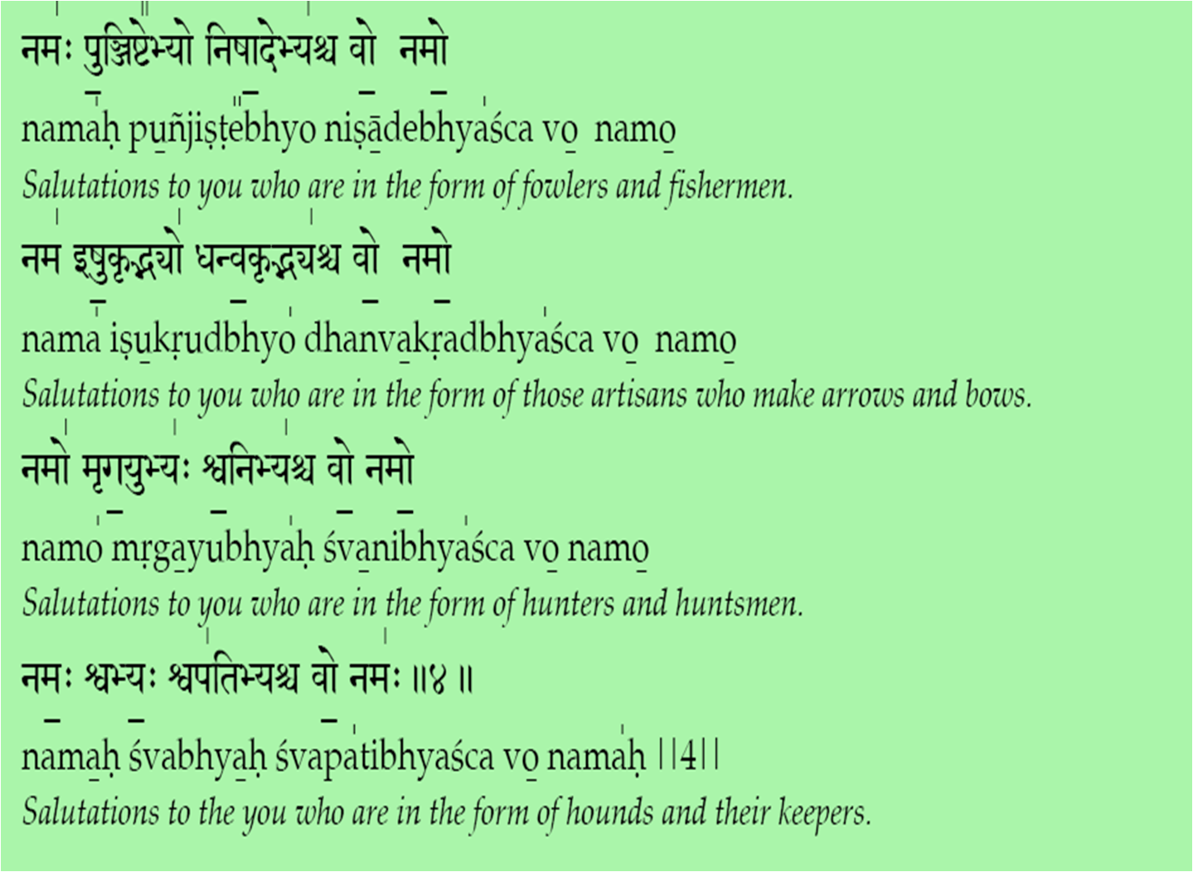
̱

Slide 24
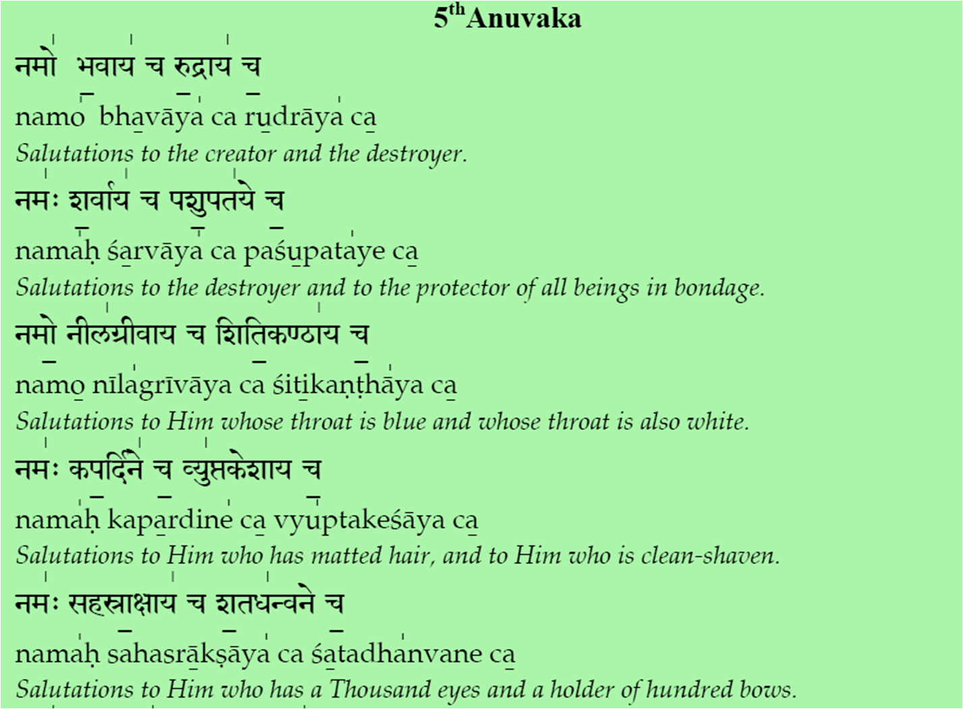
̱

Slide 25
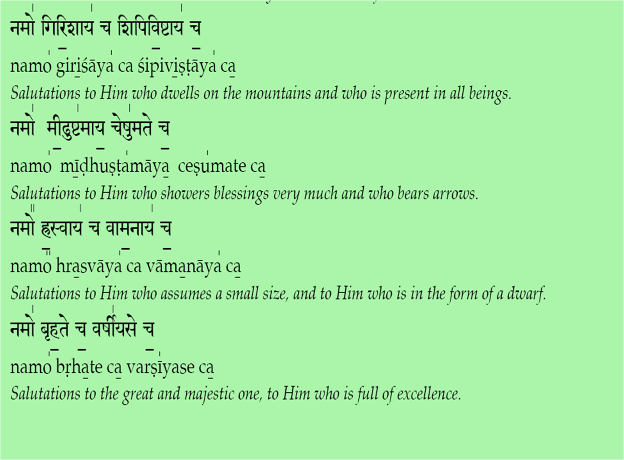
̱

Slide 26
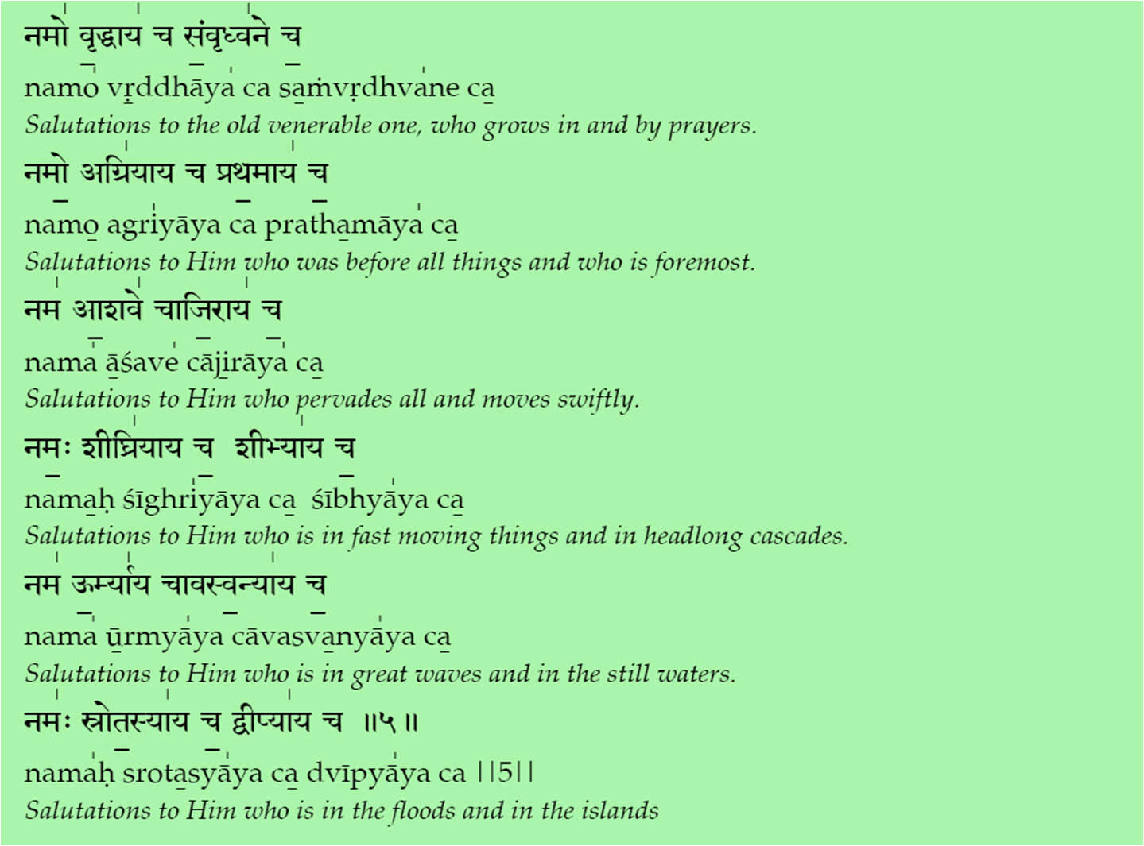
̱
Notes:
26

Slide 27
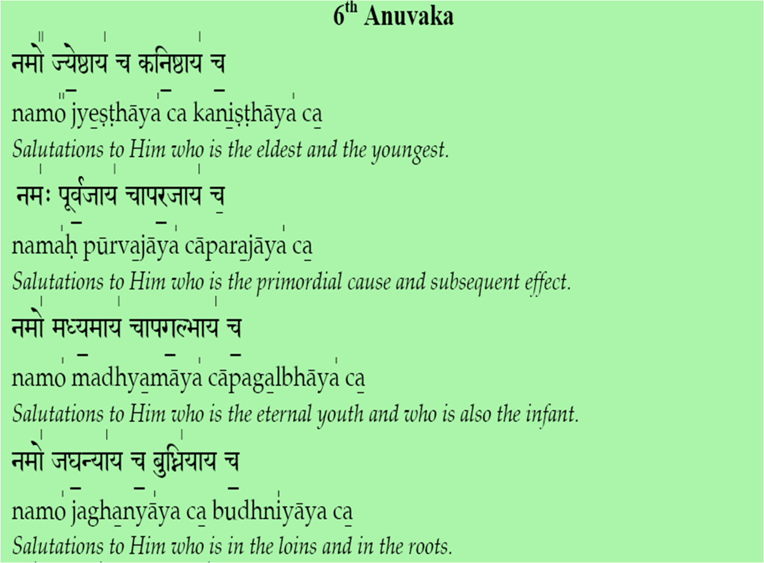
̱

Slide 28
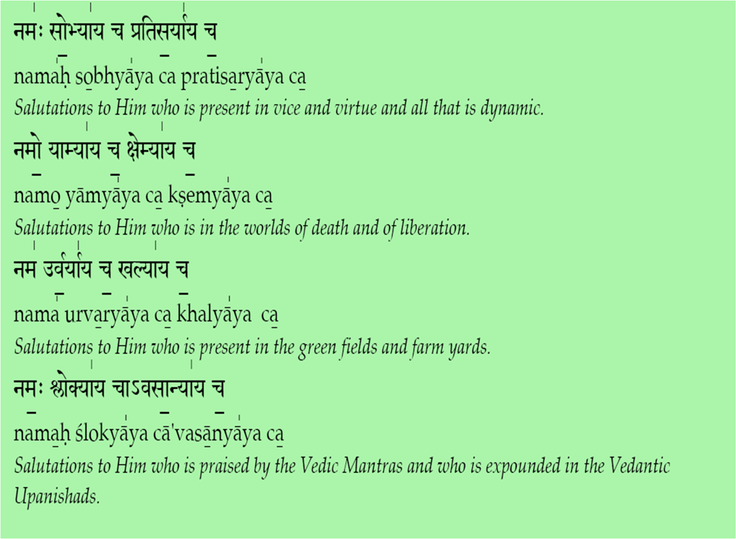
̱

Slide 29
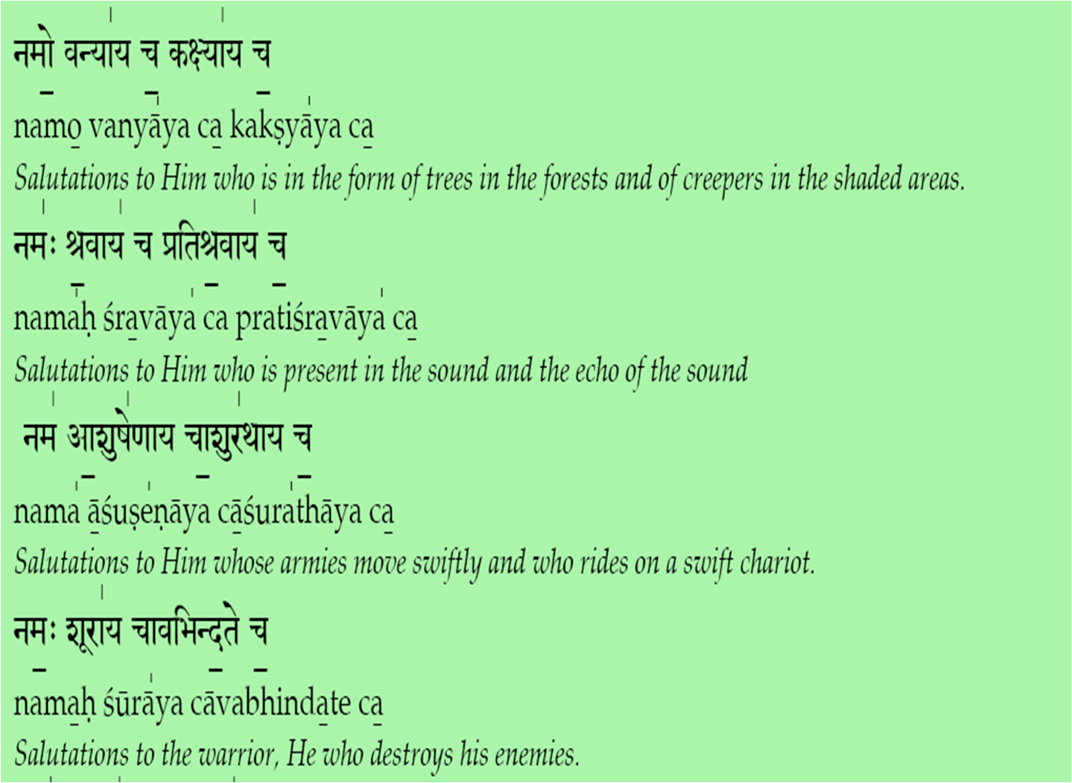
̱

Slide 30
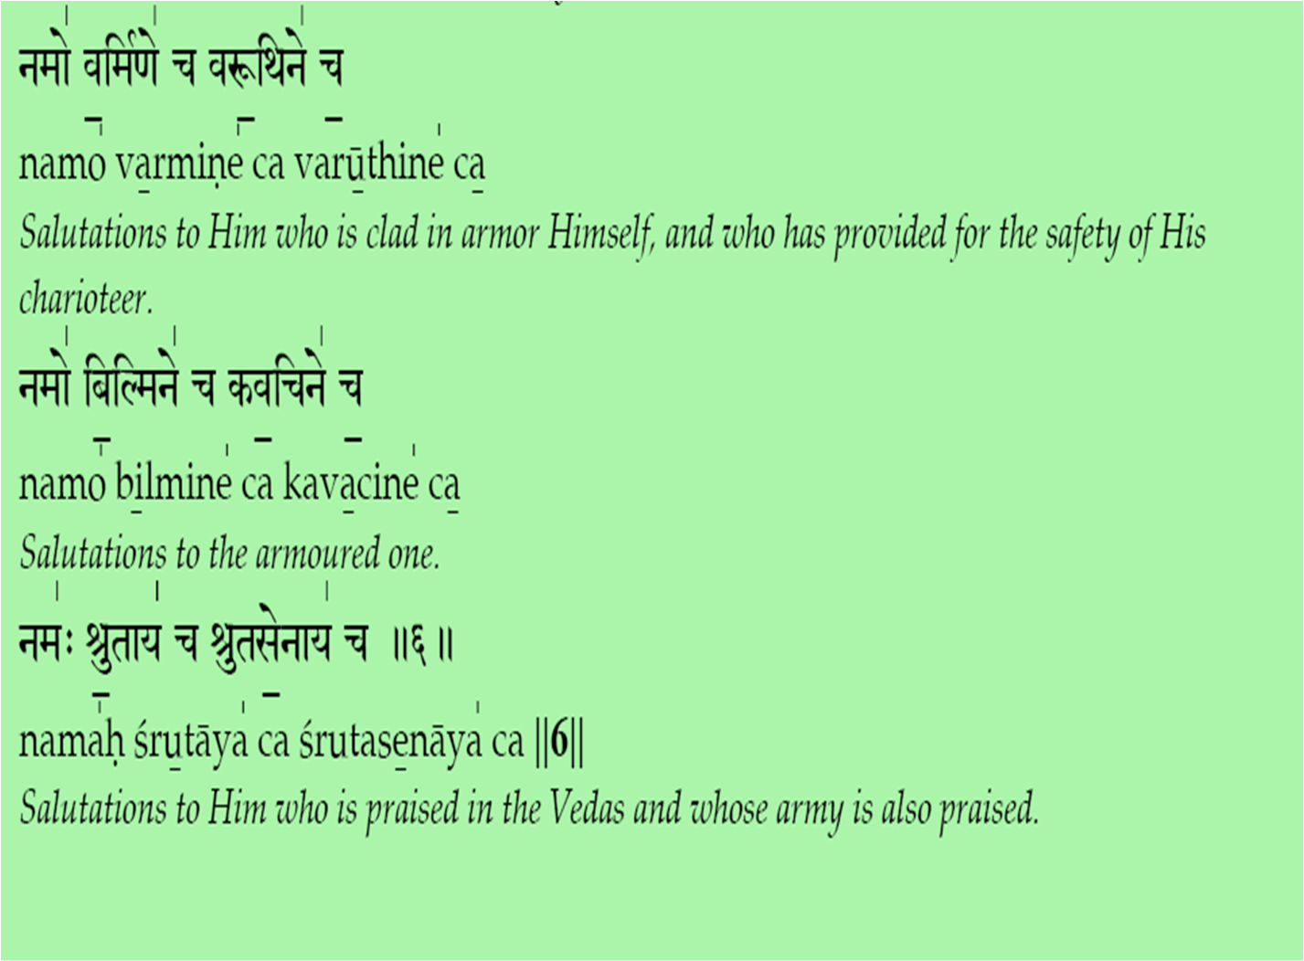
̱

Slide 31
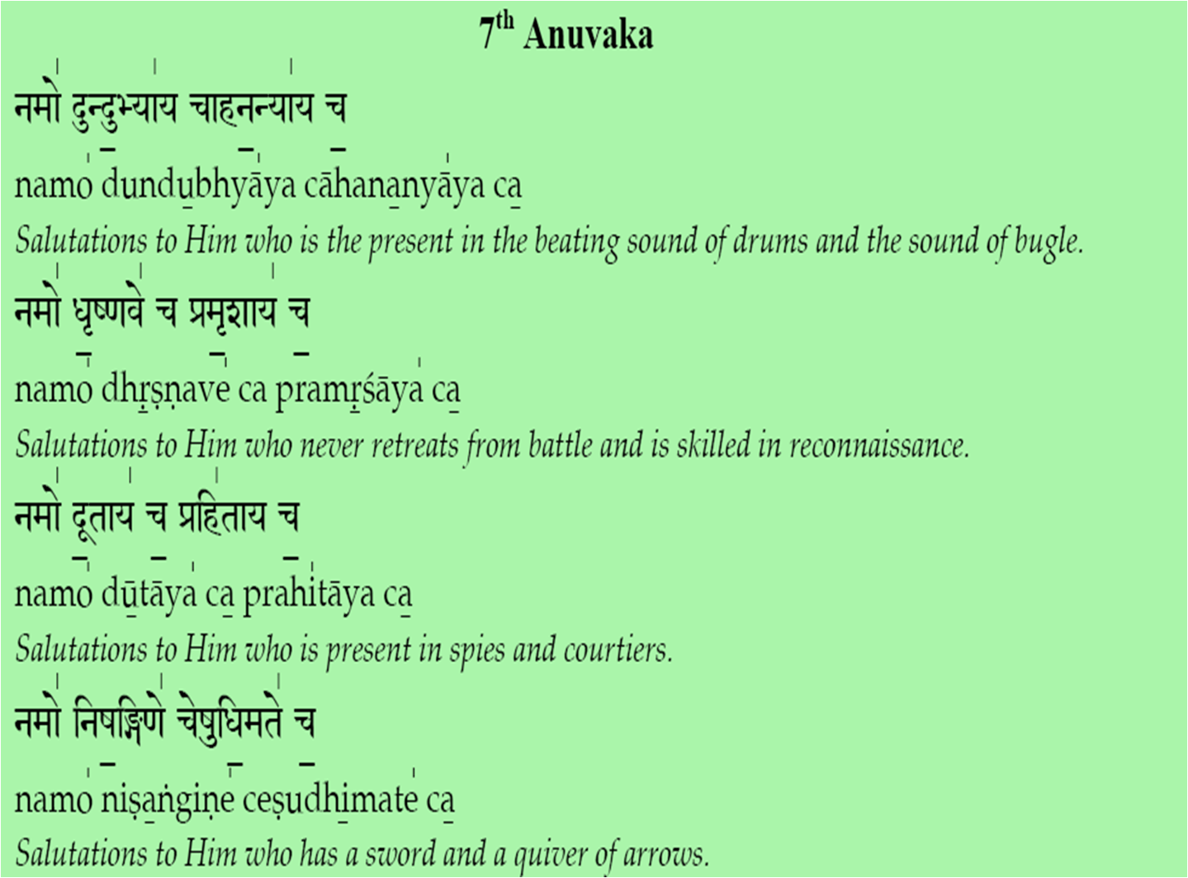
̱

Slide 32
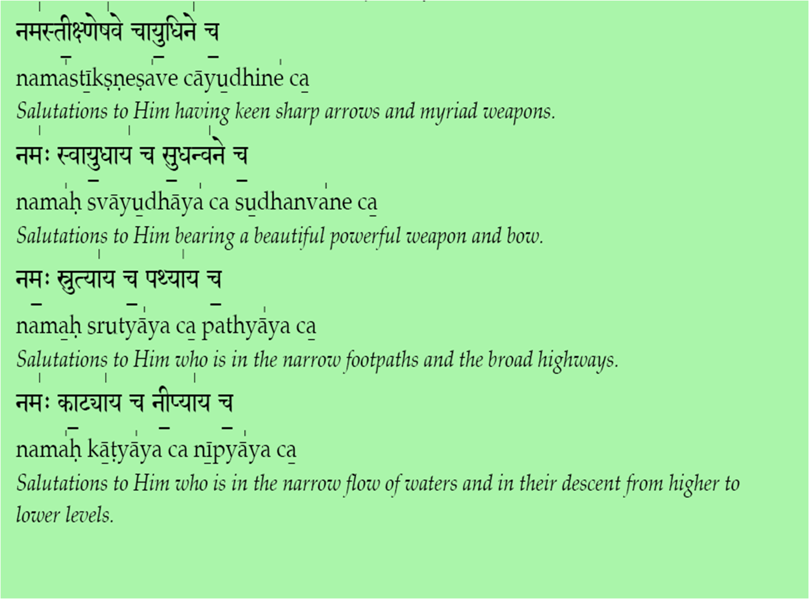
̱

Slide 33
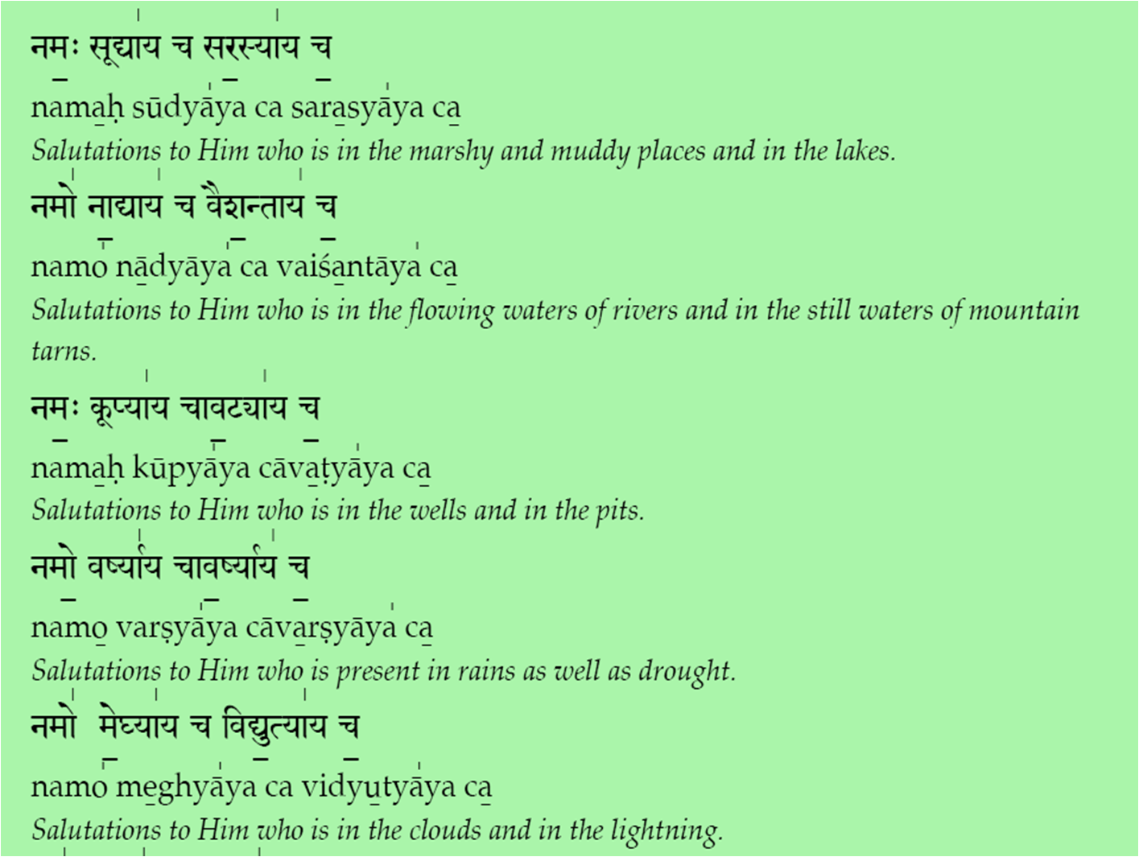
̱

Slide 34
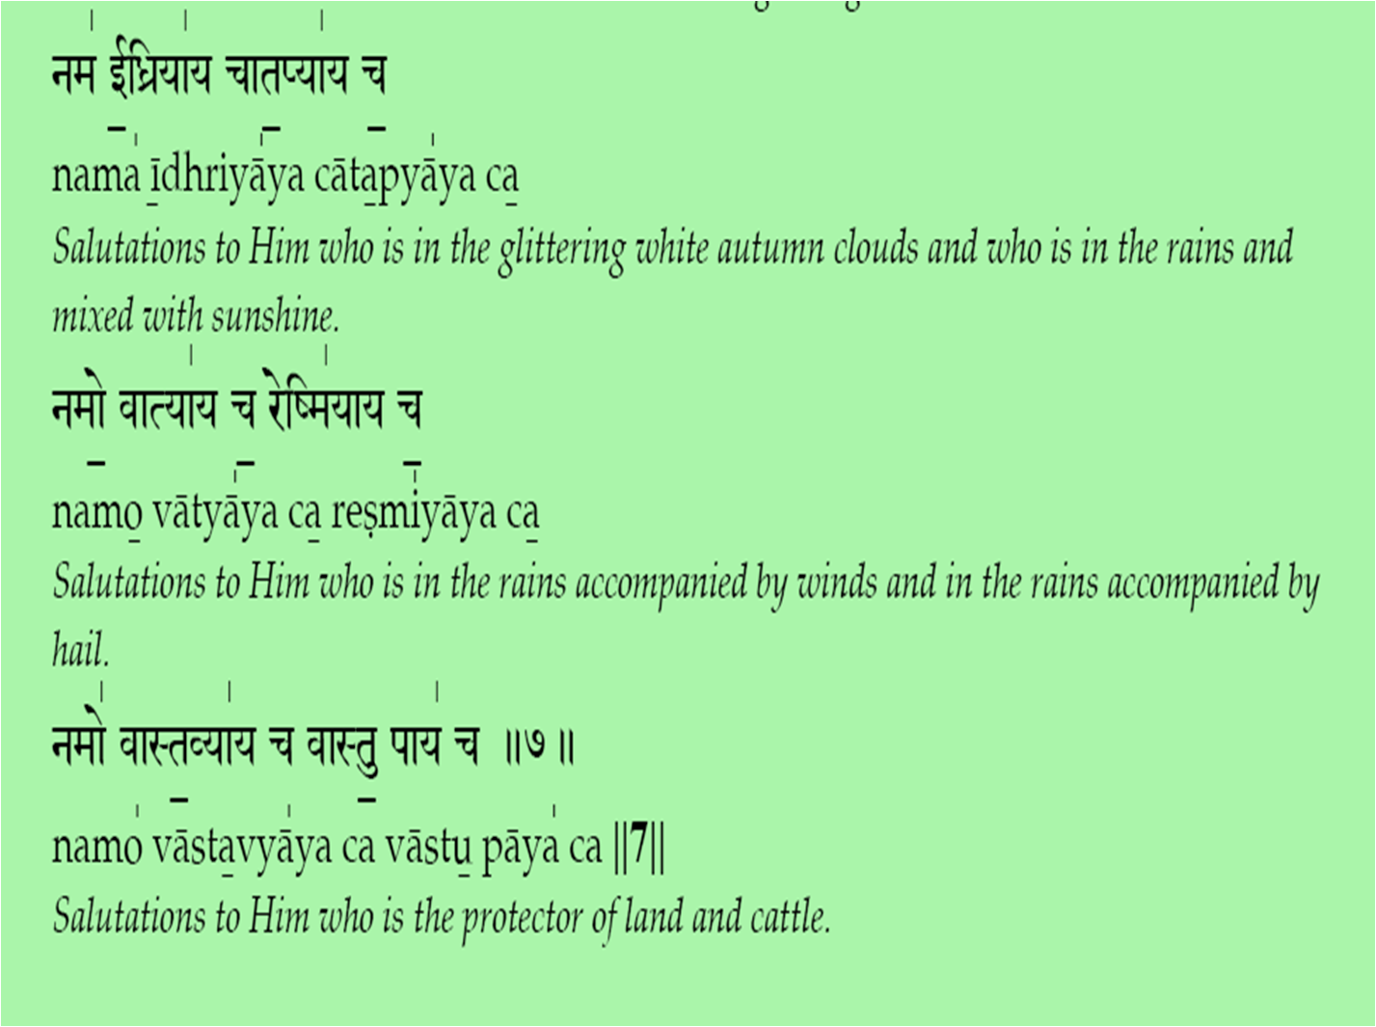
̱

Slide 35
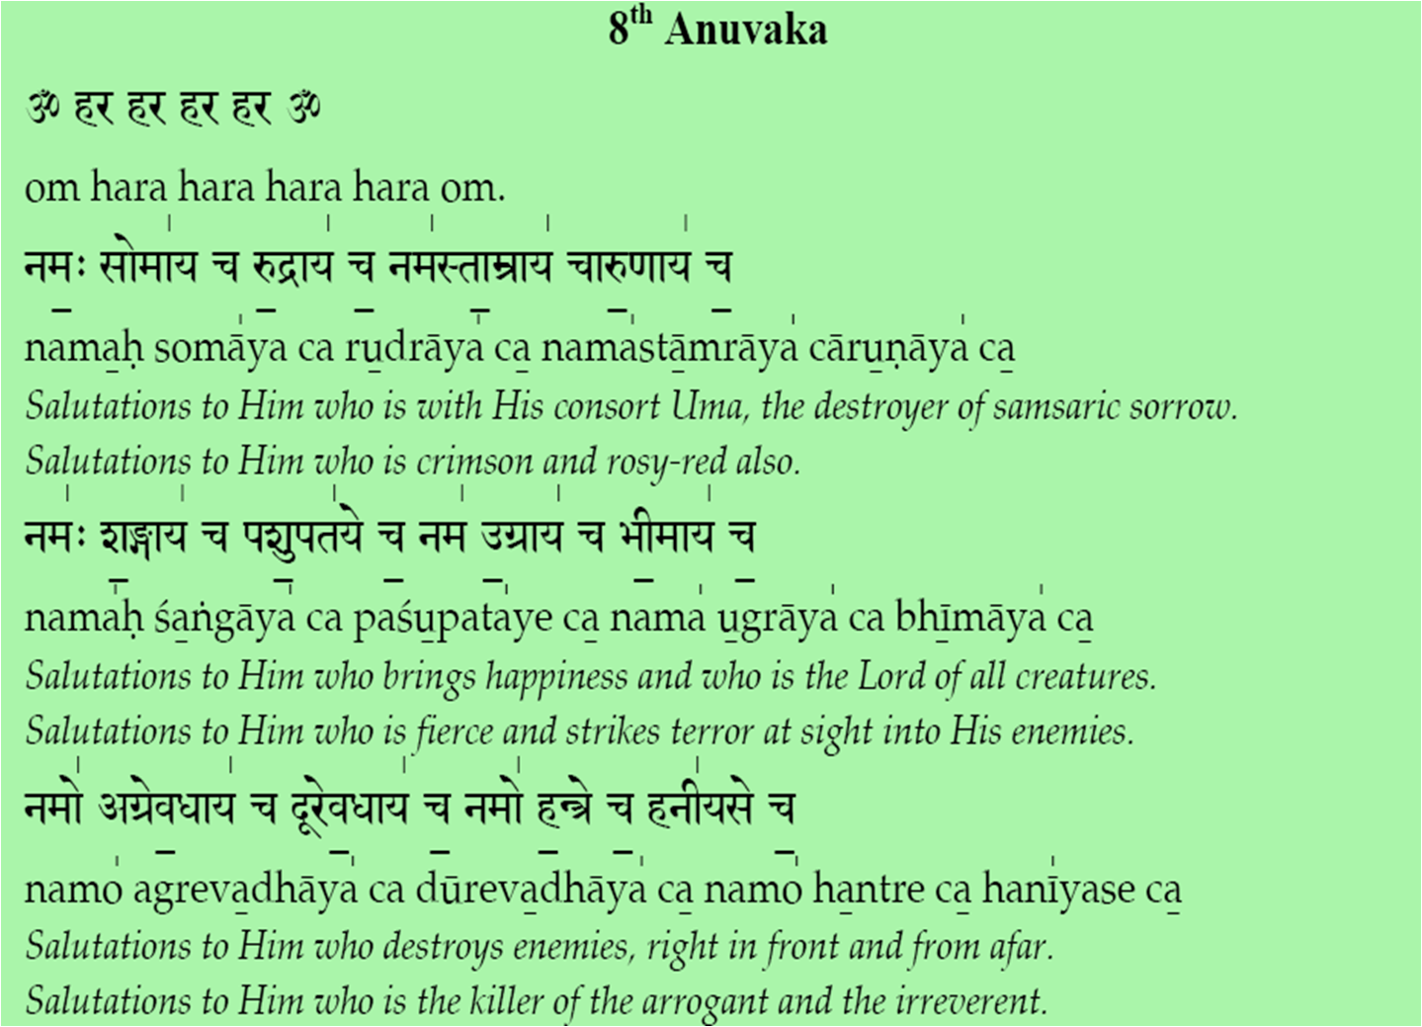
̱

Slide 36
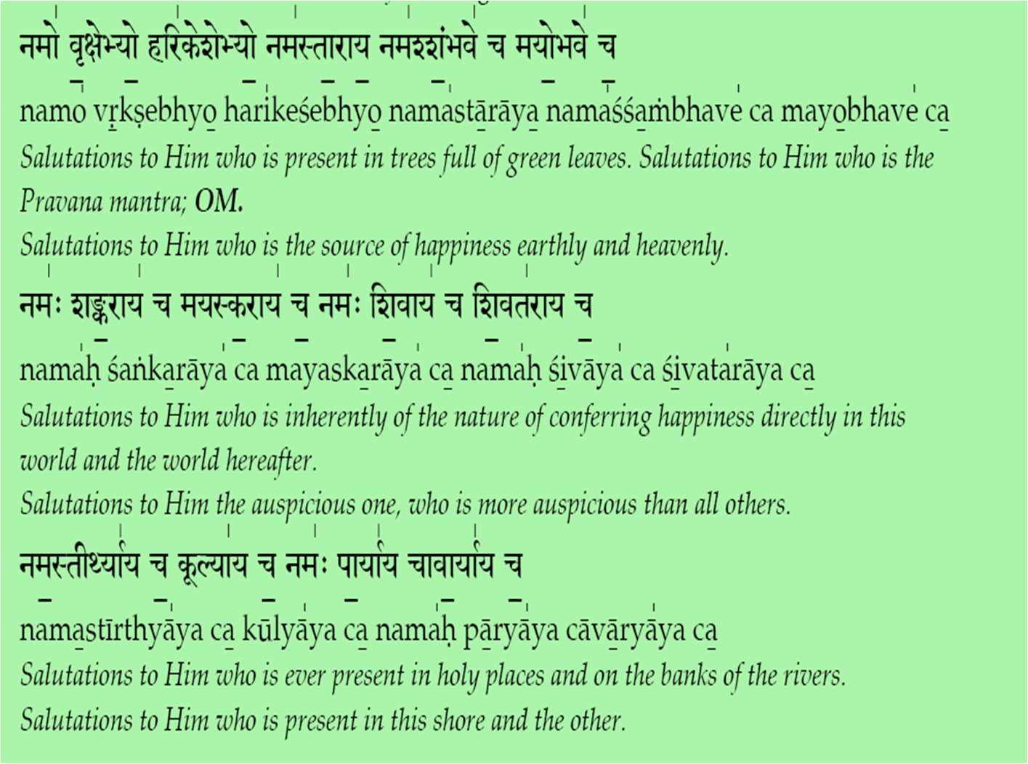
̱

Slide 37
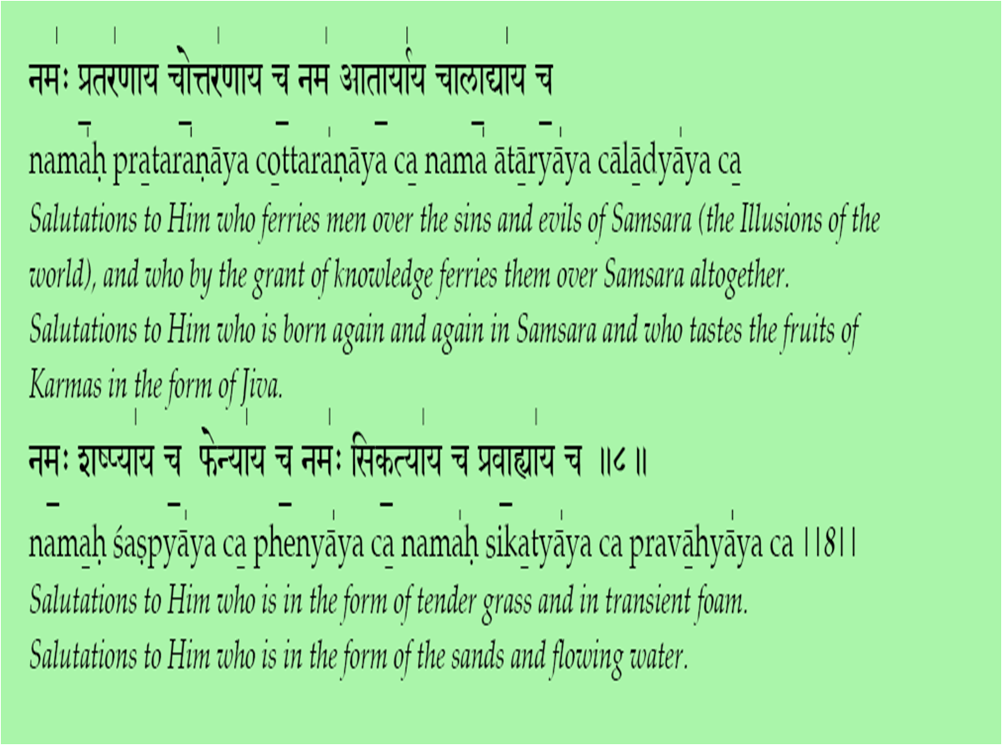
̱

Slide 38
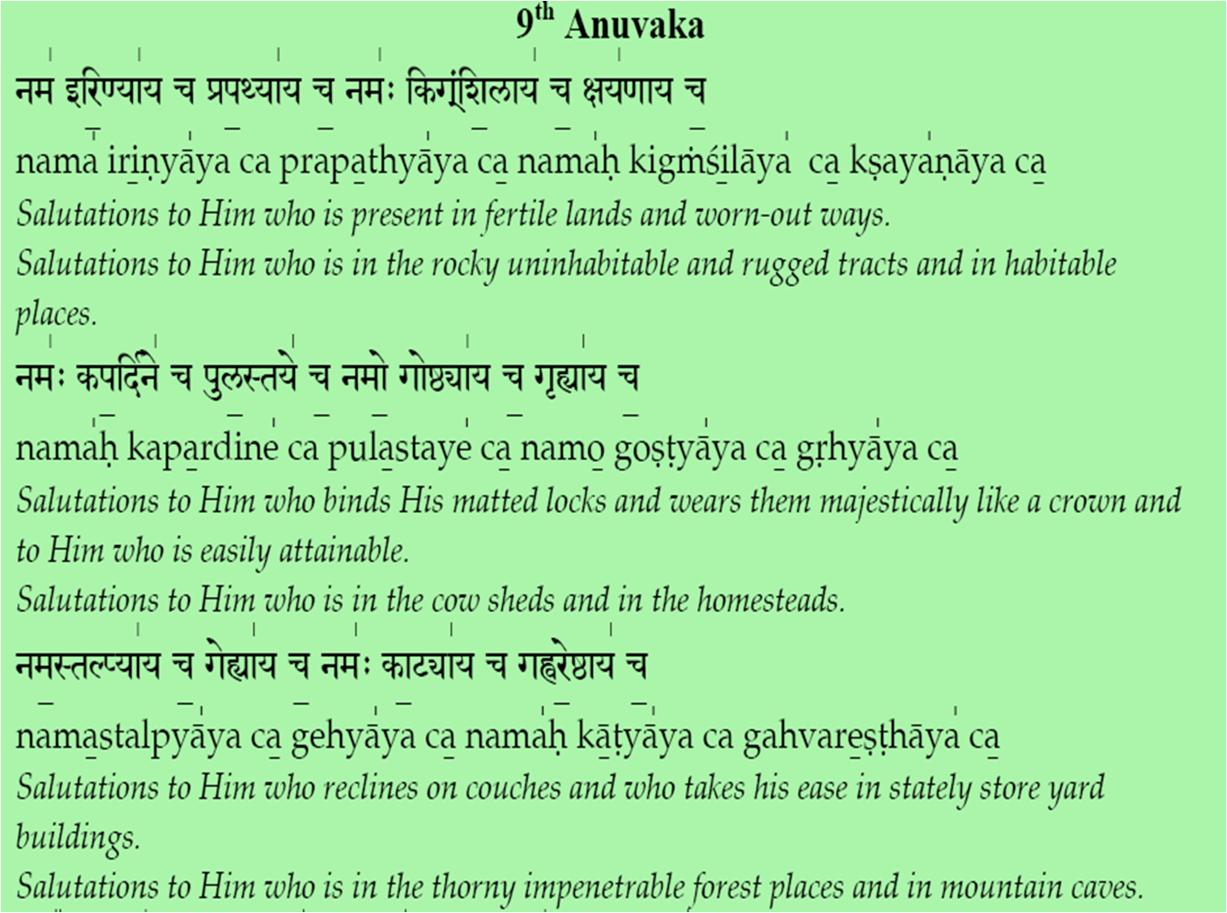
̱

Slide 39
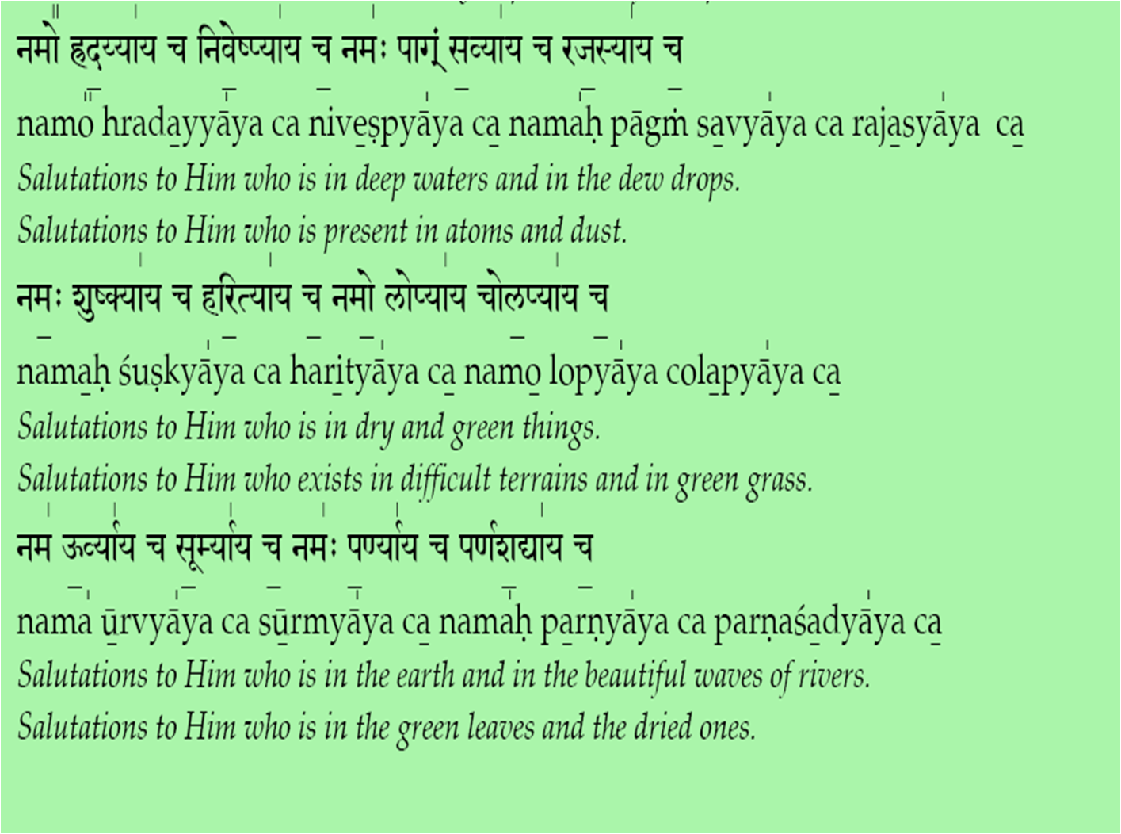
̱

Slide 40
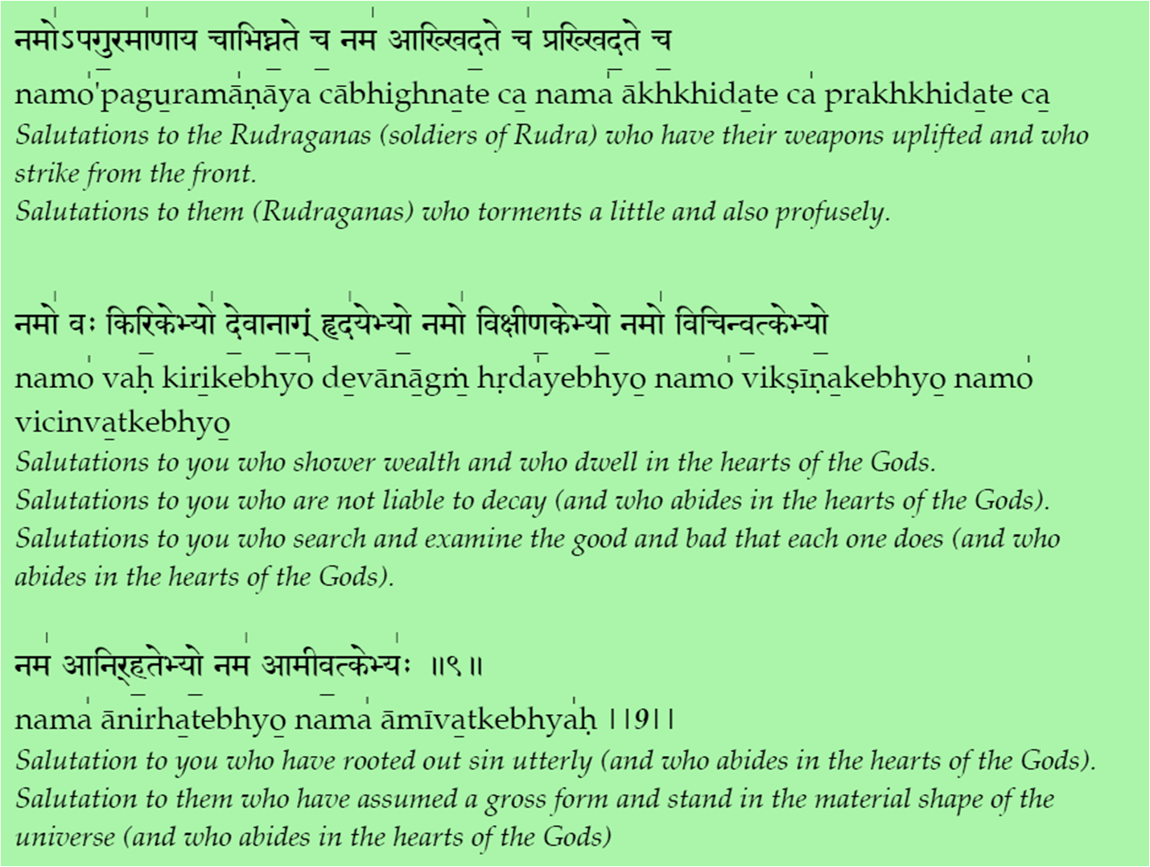
̱

Slide 41
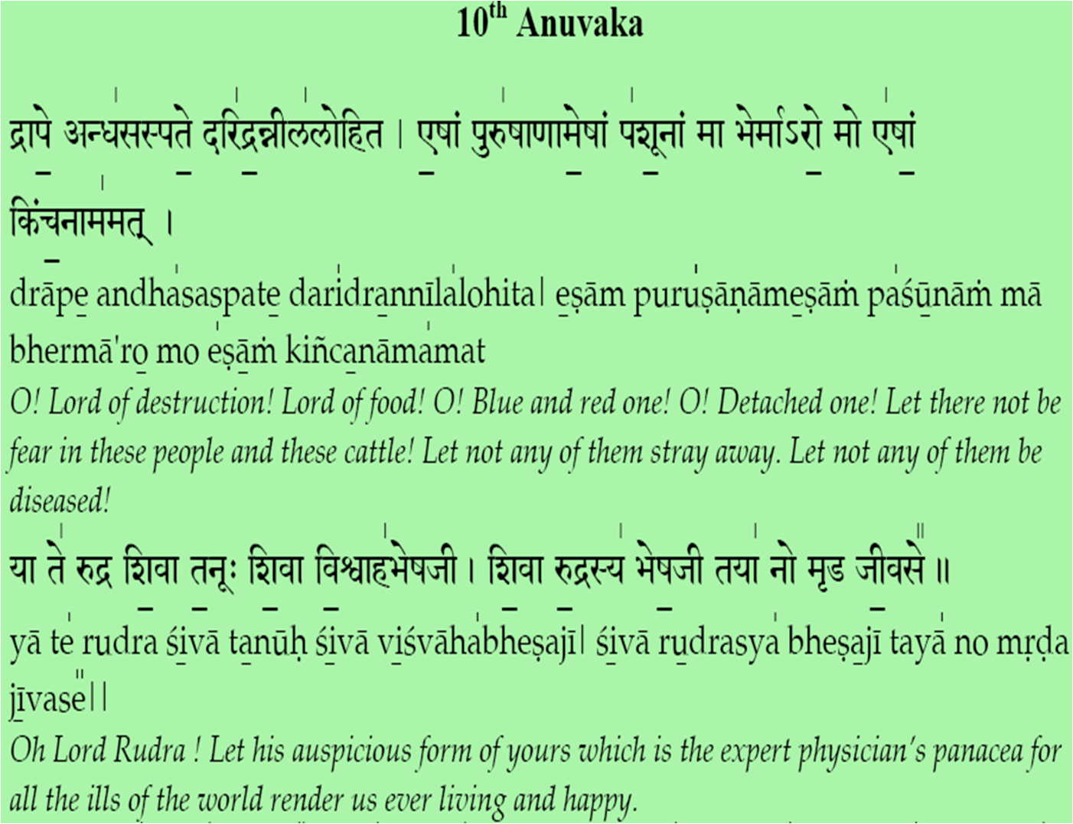
̱

Slide 42
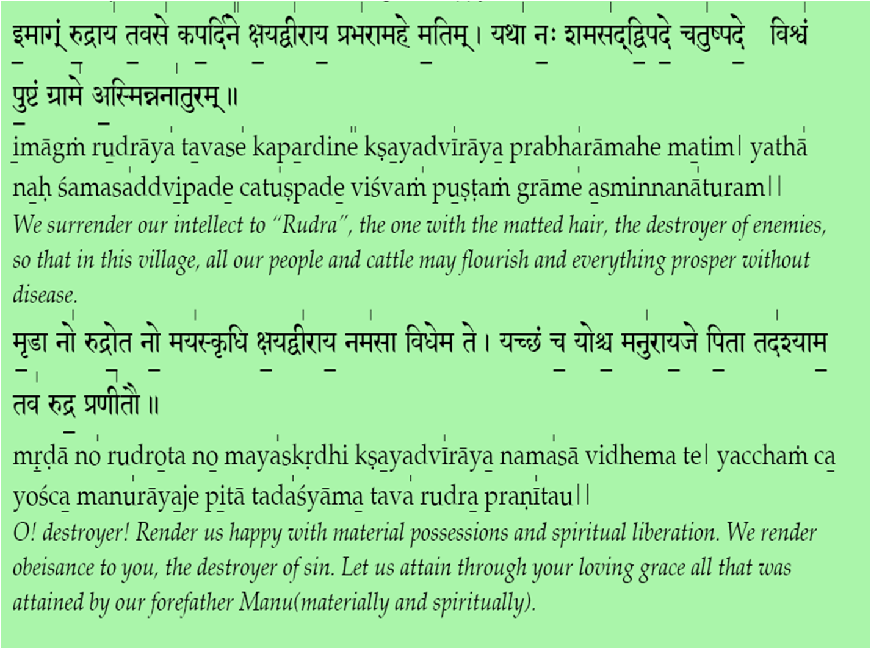
̱

Slide 43
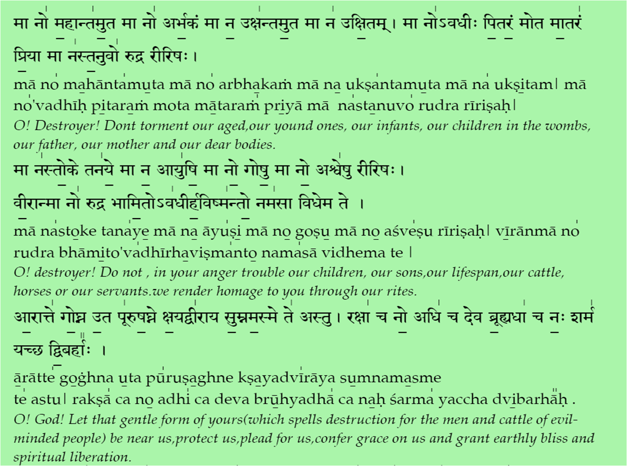
̱

Slide 44
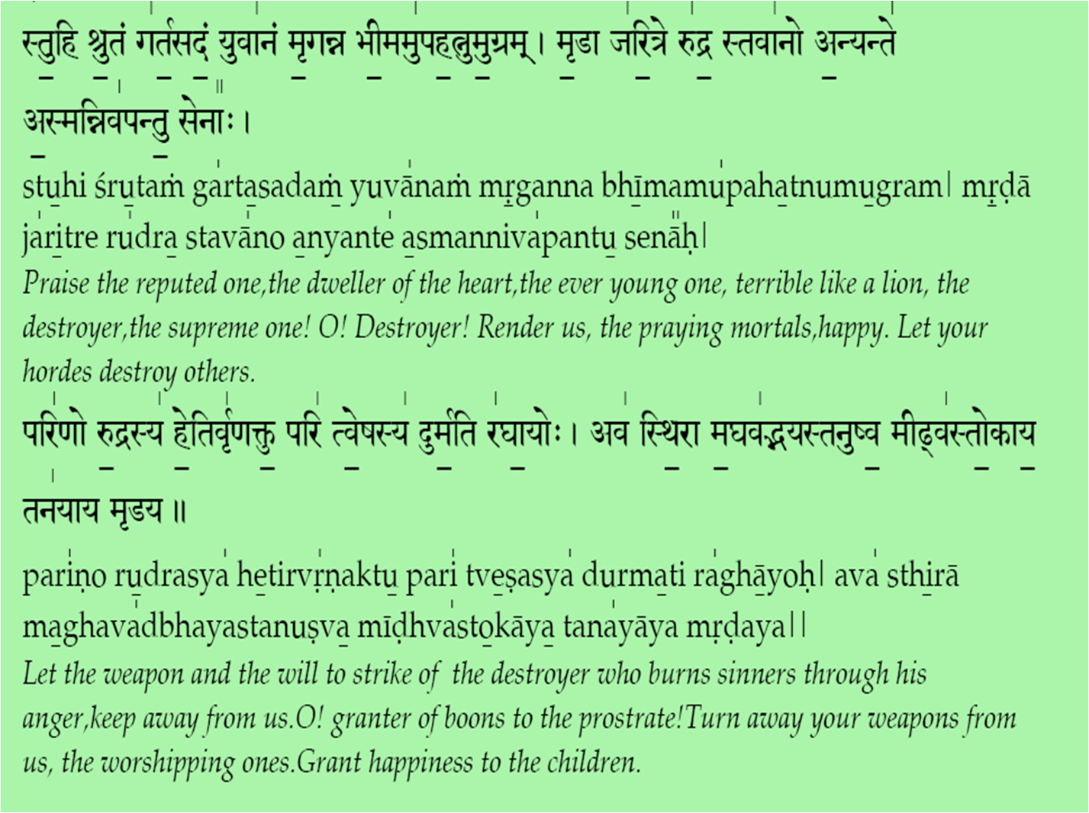
̱

Slide 45
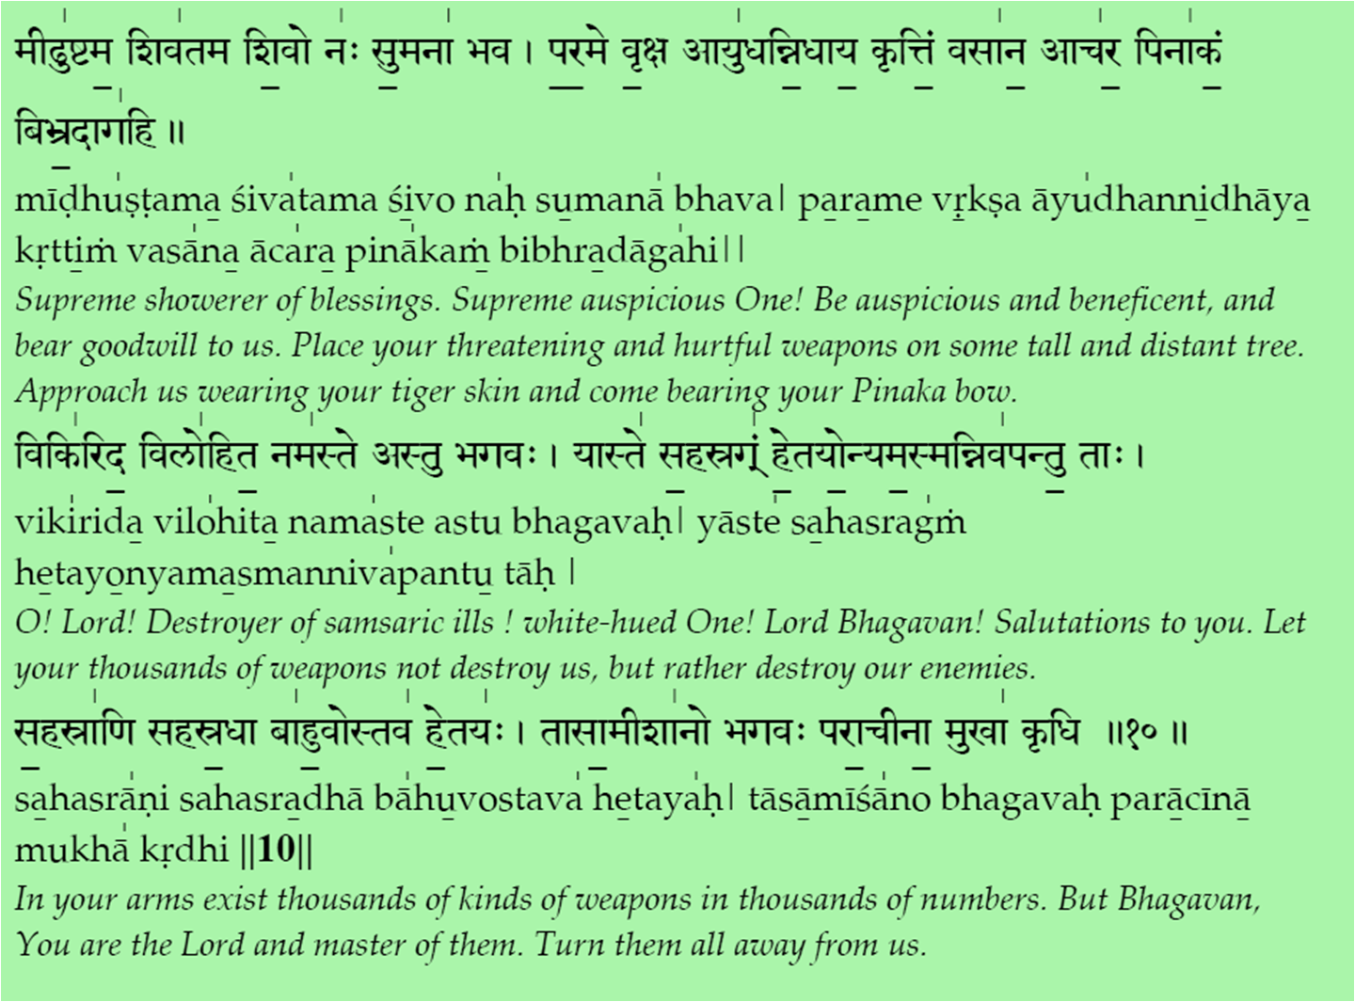
̱

Slide 46
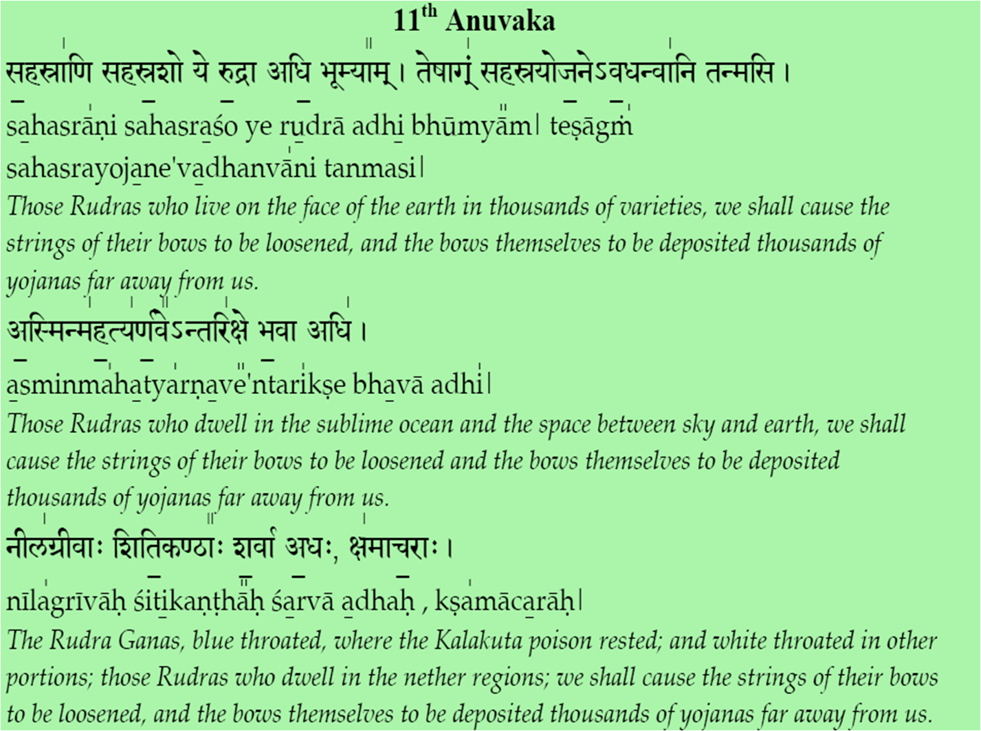
̱

Slide 47
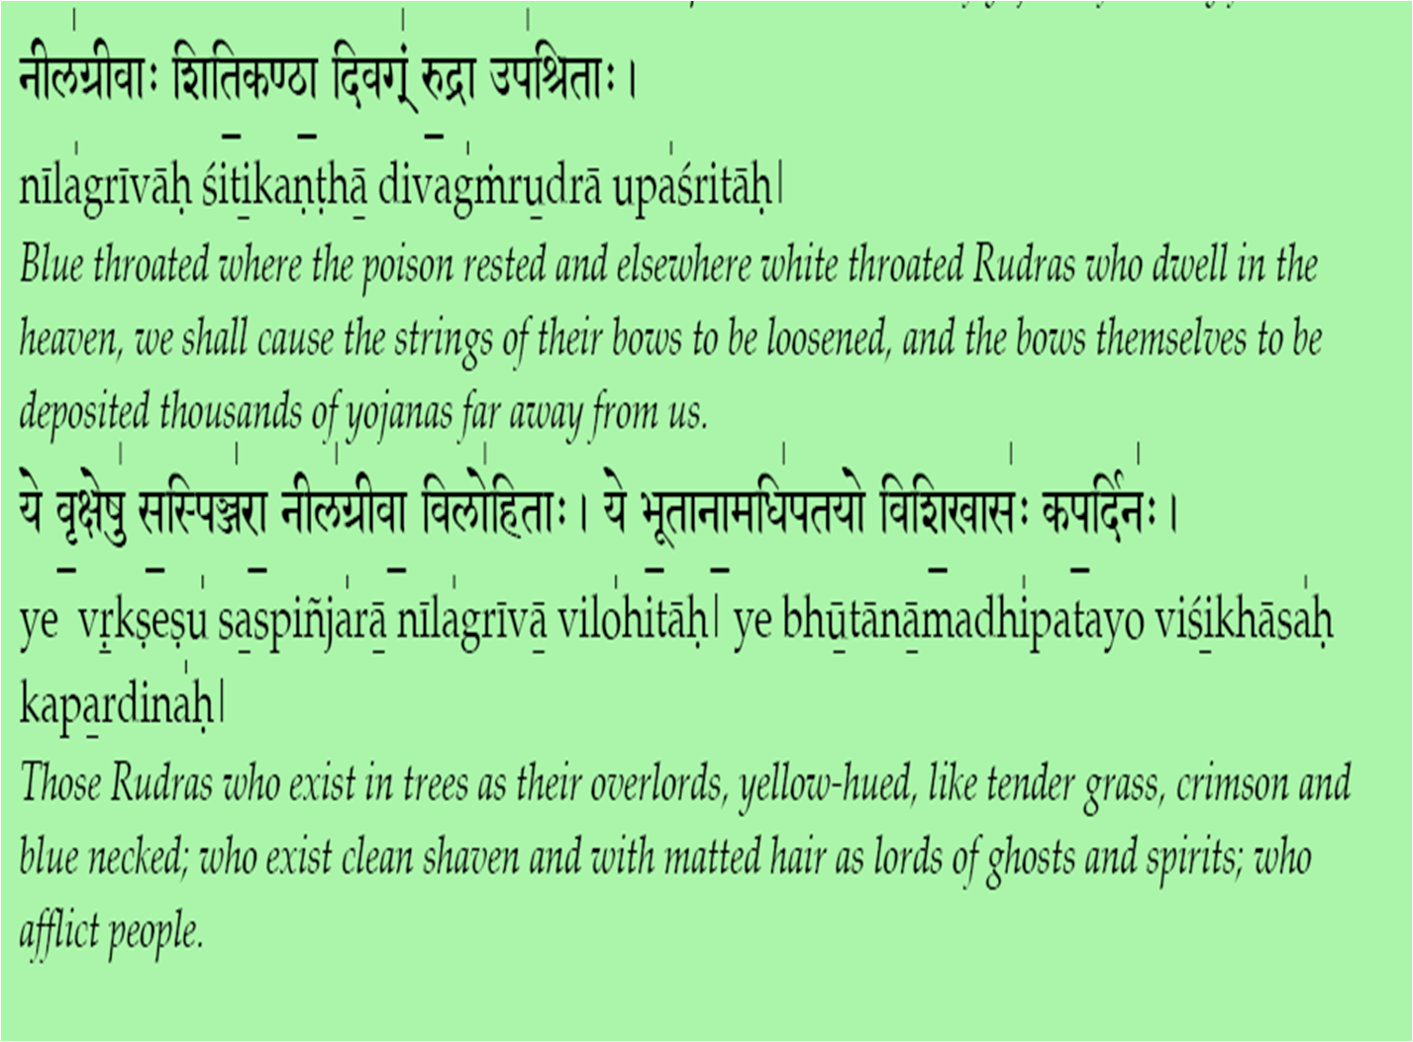
̱

Slide 48
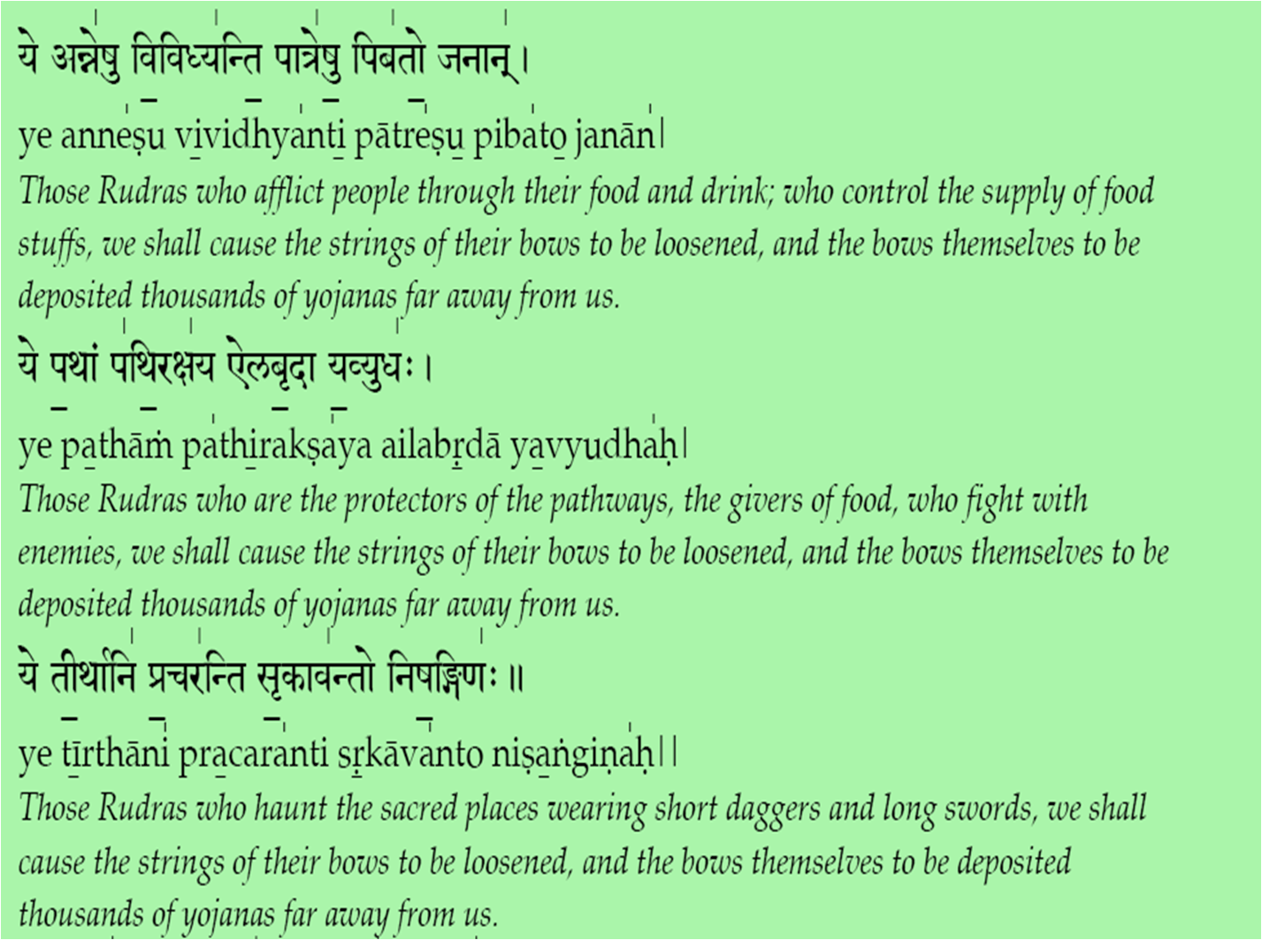
̱

Slide 49
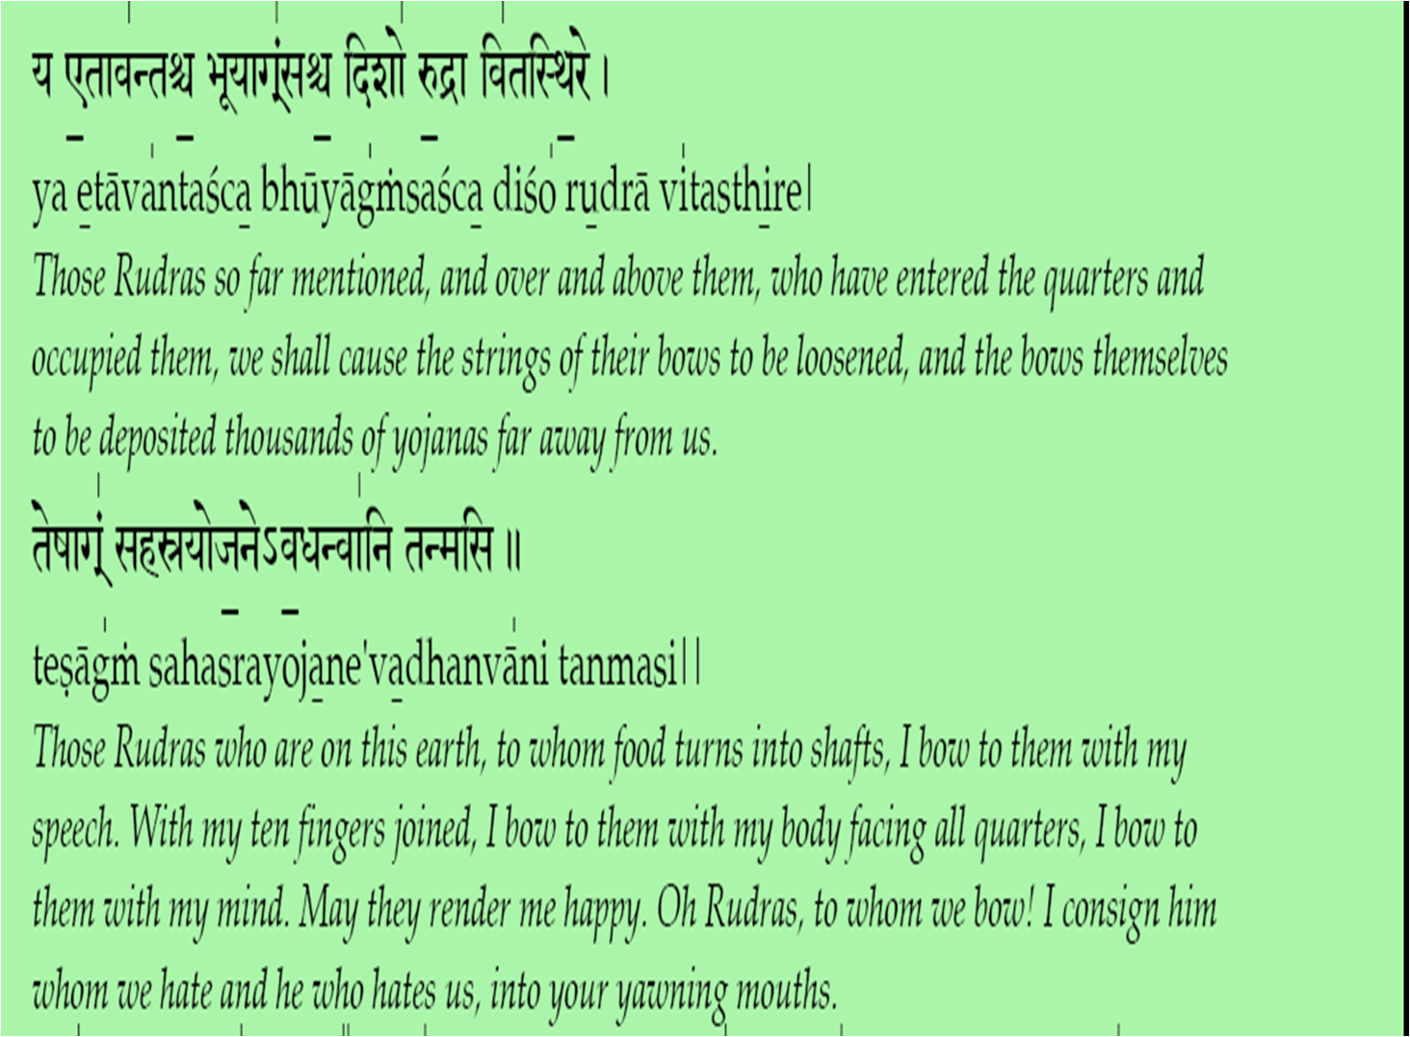
̱

Slide 50
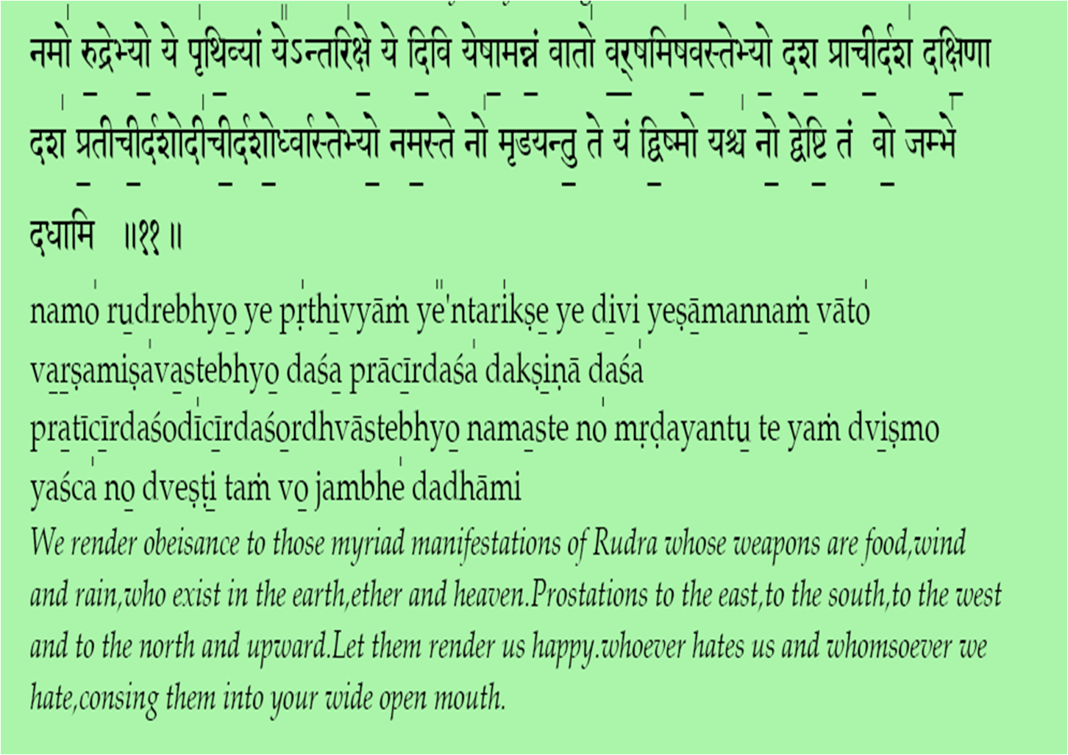
̱

Slide 51
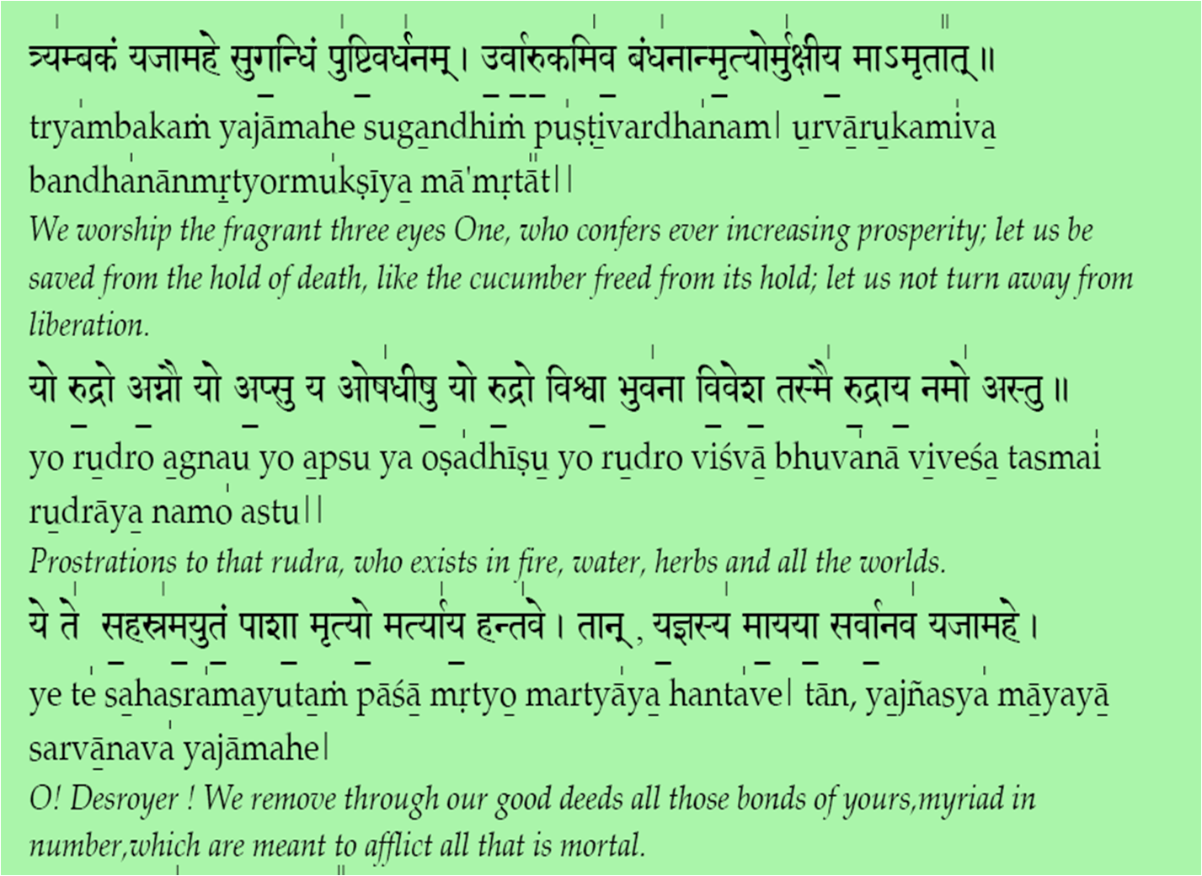
̱

Slide 52
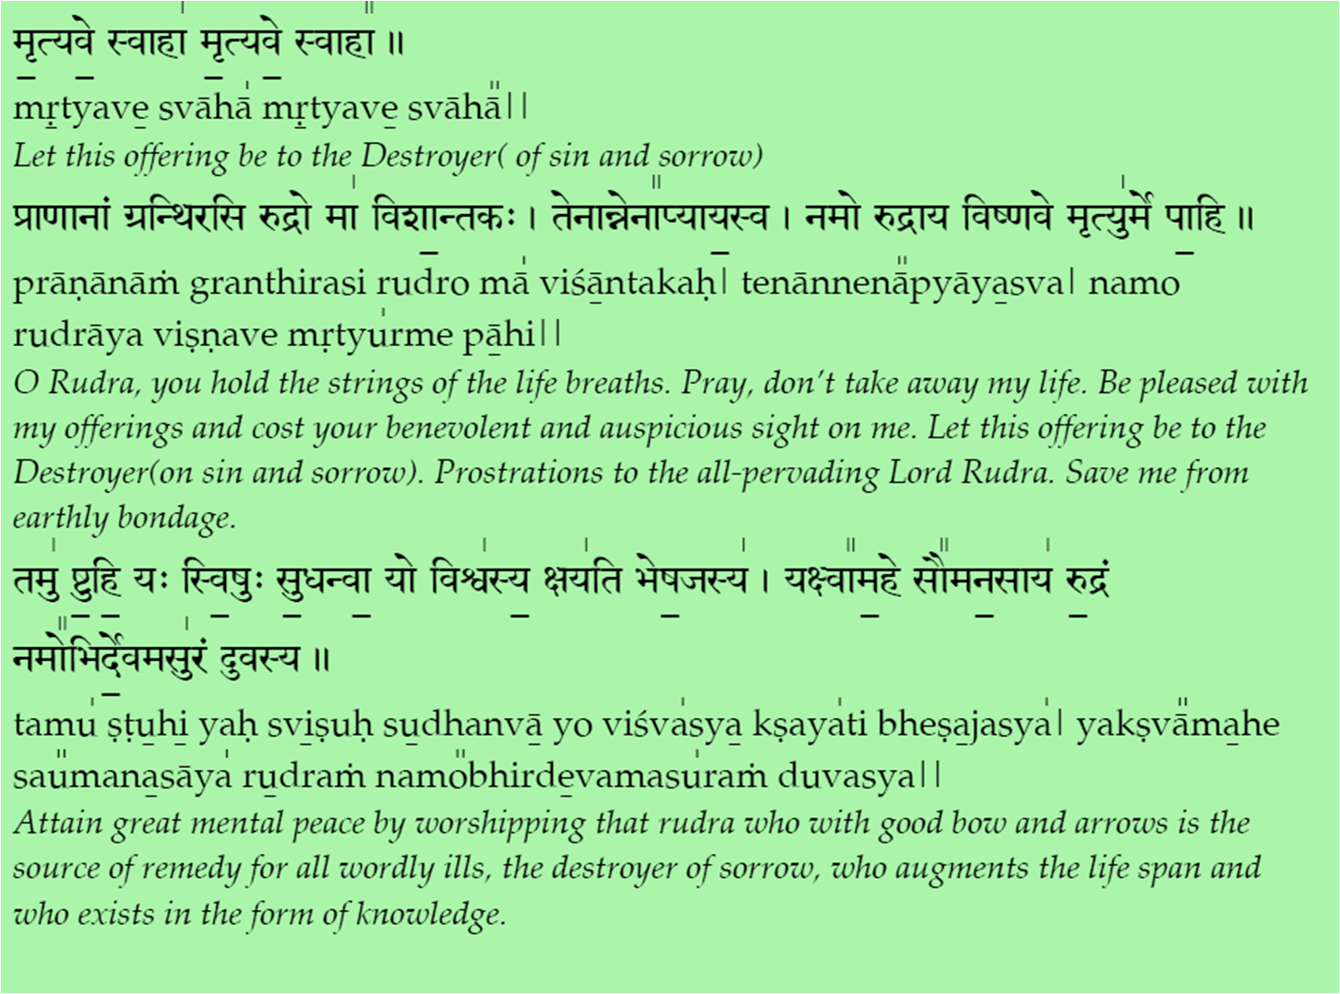
̱

Slide 53
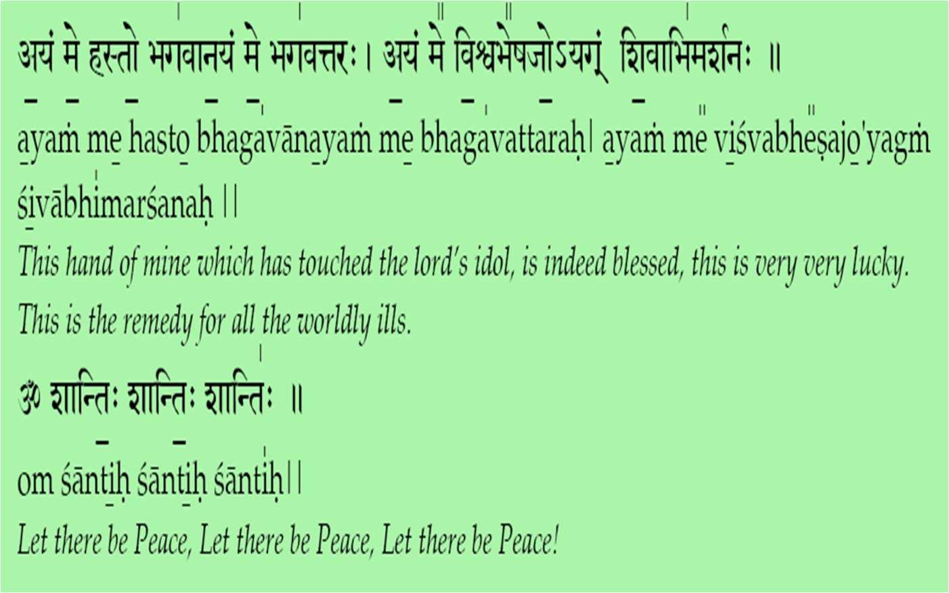
̱

Slide 54
Kshama Prarthana
Yadaksarapadabhrastam matrahinam tu yad bhavet| tatsarvam ksamyatam deva narayana namostute
Prostrations to you O Lord Narayana. Forgive me for all the mistakes in letters of phrase or any phonetic abberation that may have occurred in my chanting.
Visargabindumatrani padapadaksarani ca | nyunani catiriktani ksamasva saiiśvara|
Forgive me O Sayeeswara, for any mistake in my pronounciation(of visarga ( : ), bindu or Intonation of alphabet, word or phrase and any other mistakes.
aparadha sahasrani kriyante harniśam maya | dasoyamiti mam
matva ksamasva sayiśvara|
O Sayeeswara, considering me as Your servant, forgive the thousands of sins Committed by me throughout the day and night.
anyatha śaranam nasti tvameva śaranam mama.tasmat karunya
bhavena raksa raksa sayiśvara |
You are the only refuge for there is none else. Therefore, in Your compassion O Sayeesvara, protect me.
Harih om tatst śri sayiśvararpanamastu |
May this prayer be an offering to Sri Sayeeswara.
Om śantih śantih śantih

